Slide 1






Slide 2
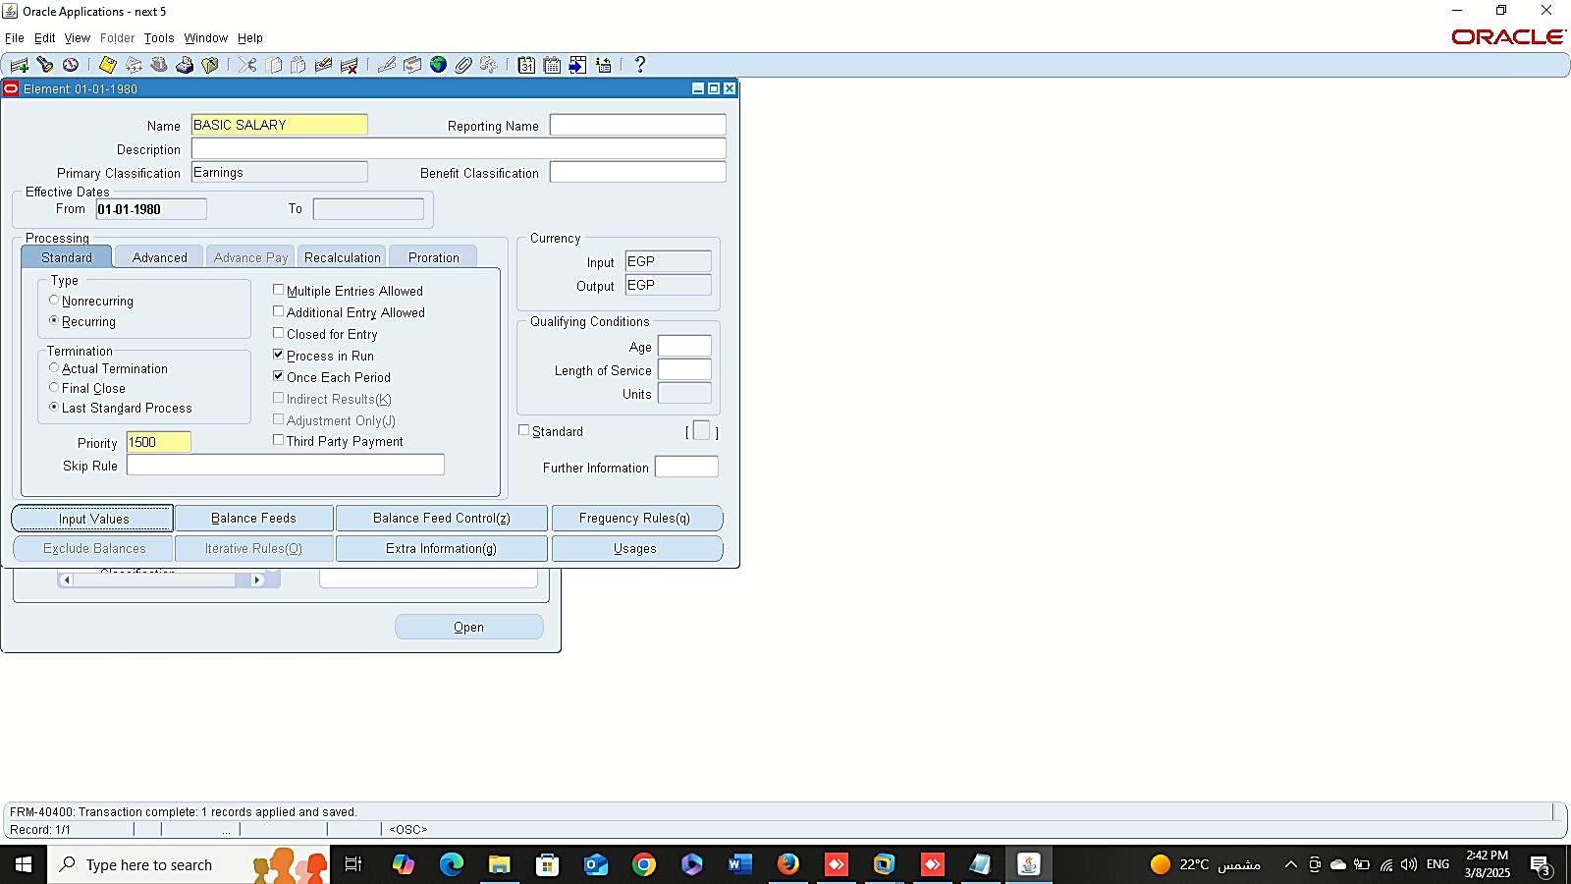
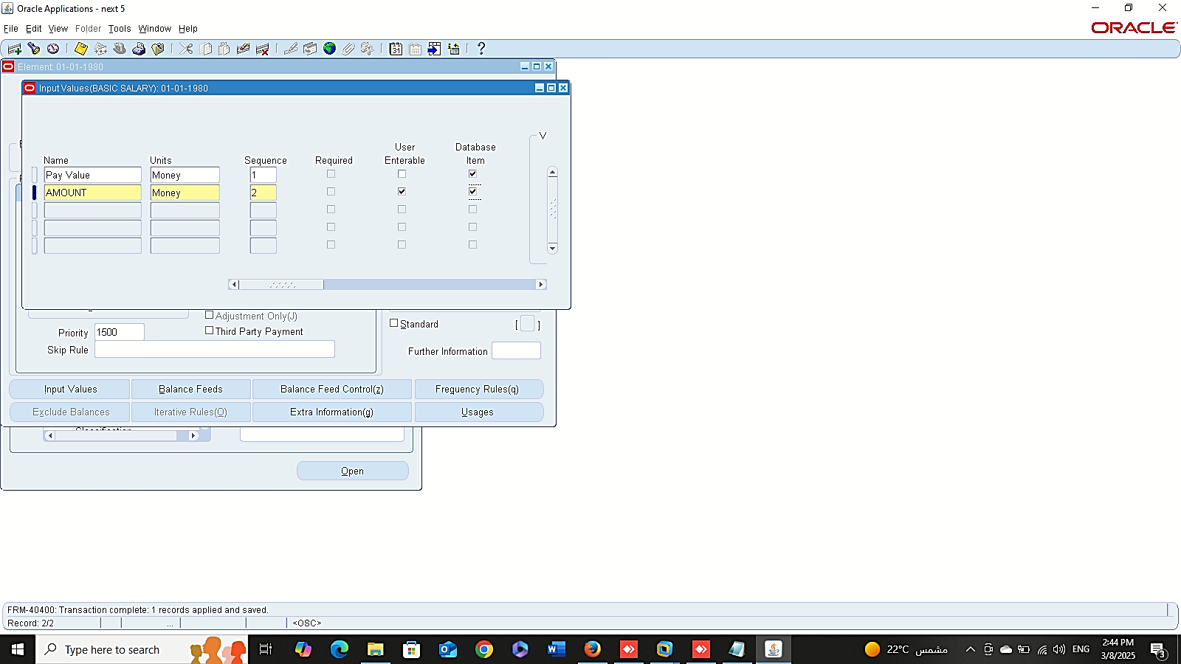
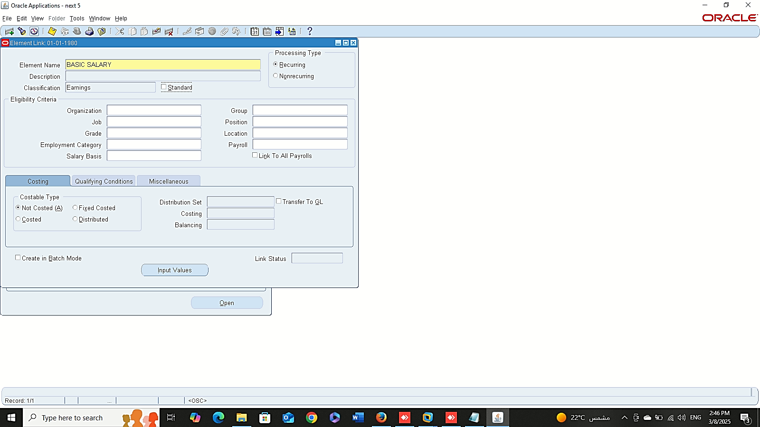
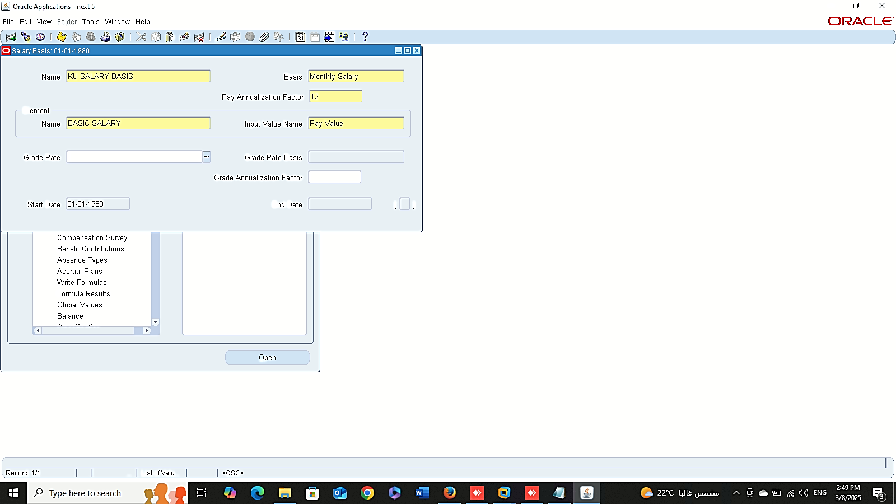
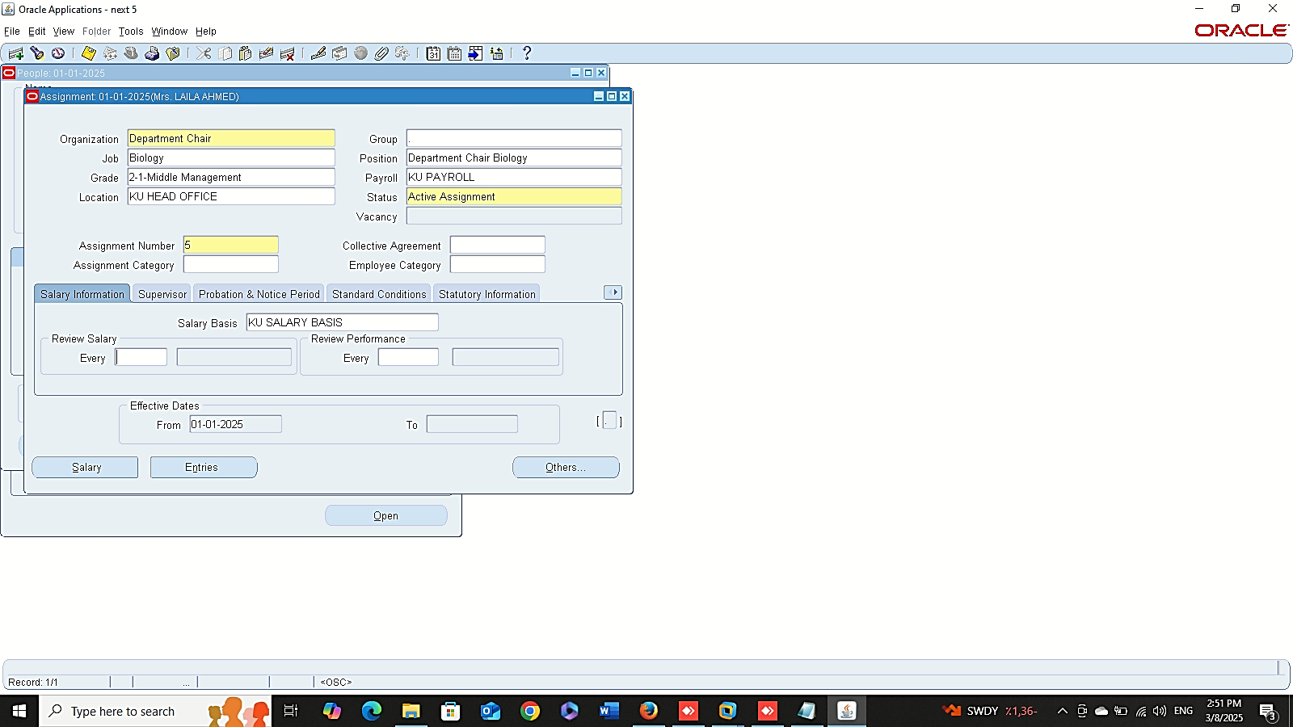
Create Salary Element
Finance Management (Payroll)
Setting Up Salary Administration
1- Create Salary Element
GLOBAL HRMS MANAGER > TOTAL COMPENSATION > BASIC > ELEMENT
2- Create A New Link
GLOBAL HRMS MANAGER > TOTAL COMPENSATION > BASIC > LINK
3- Define Salary Basis
GLOBAL HRMS MANAGER > TOTAL COMPENSATION > BASIC > SALARY BASIS
4- Assign Salary to Employee
GLOBAL HRMS MANAGER > PEOPLE > ENTER AND MAINTAIN > FIND > ASSIGMENT
Create New Link
Define Salary Basis
Assign Salary

Slide 3
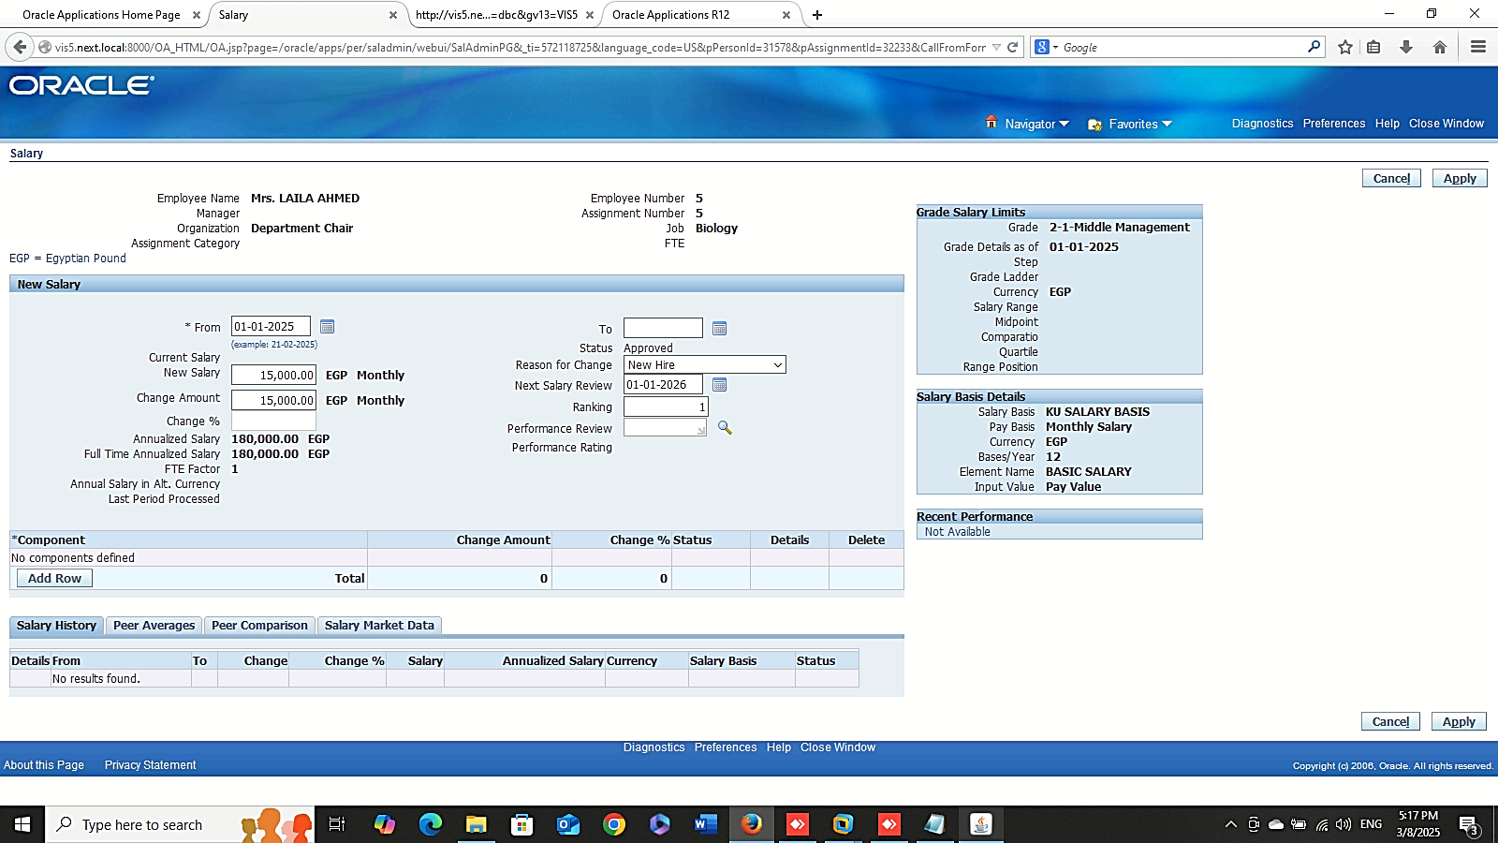
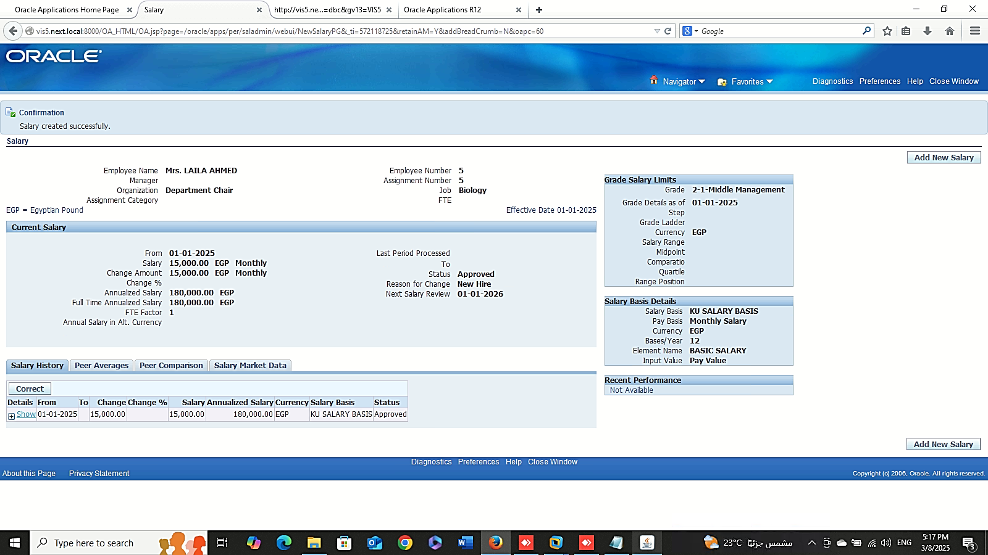
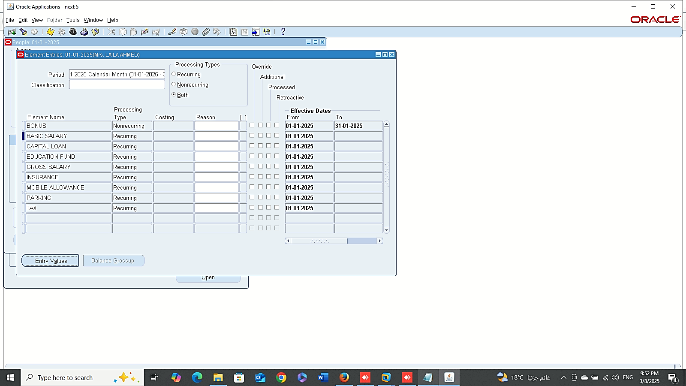
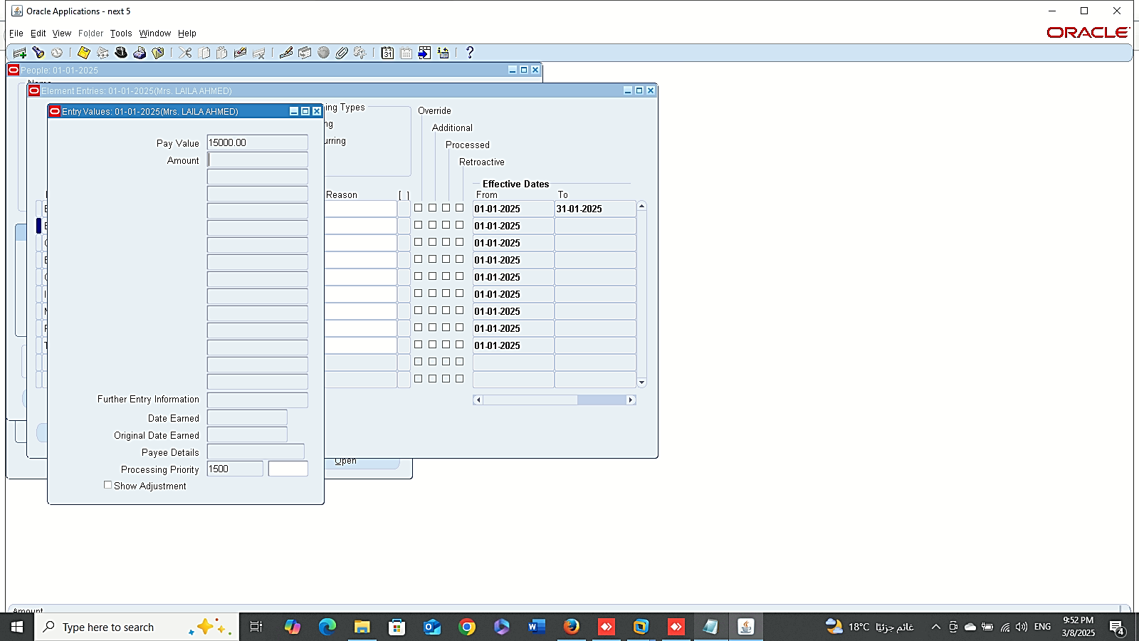
Salary Management
1
2
Finance Management (Payroll)
Salary Management
GLOBAL HRMS MANAGER > PEOPLE > ENTER AND MAINTAIN > FIND > ASSIGNEMENT > SALARY
3
4

Slide 4
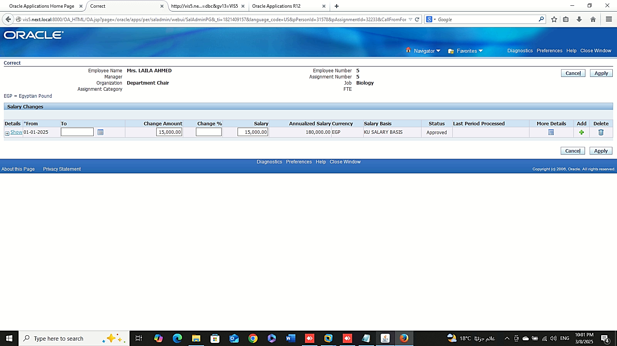

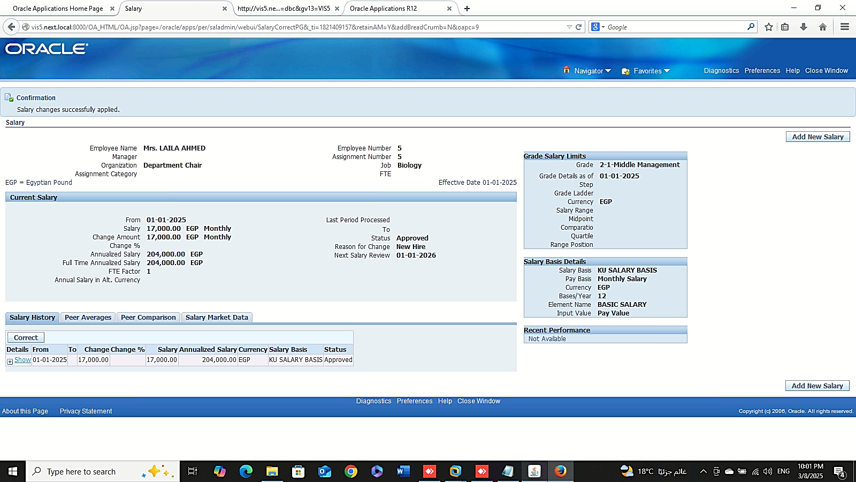
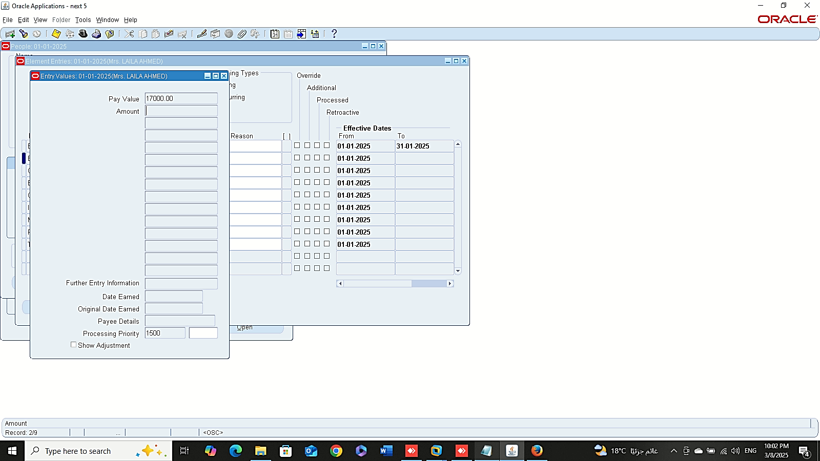
Finance Management (Payroll)
Correct Salary Basis

Slide 5
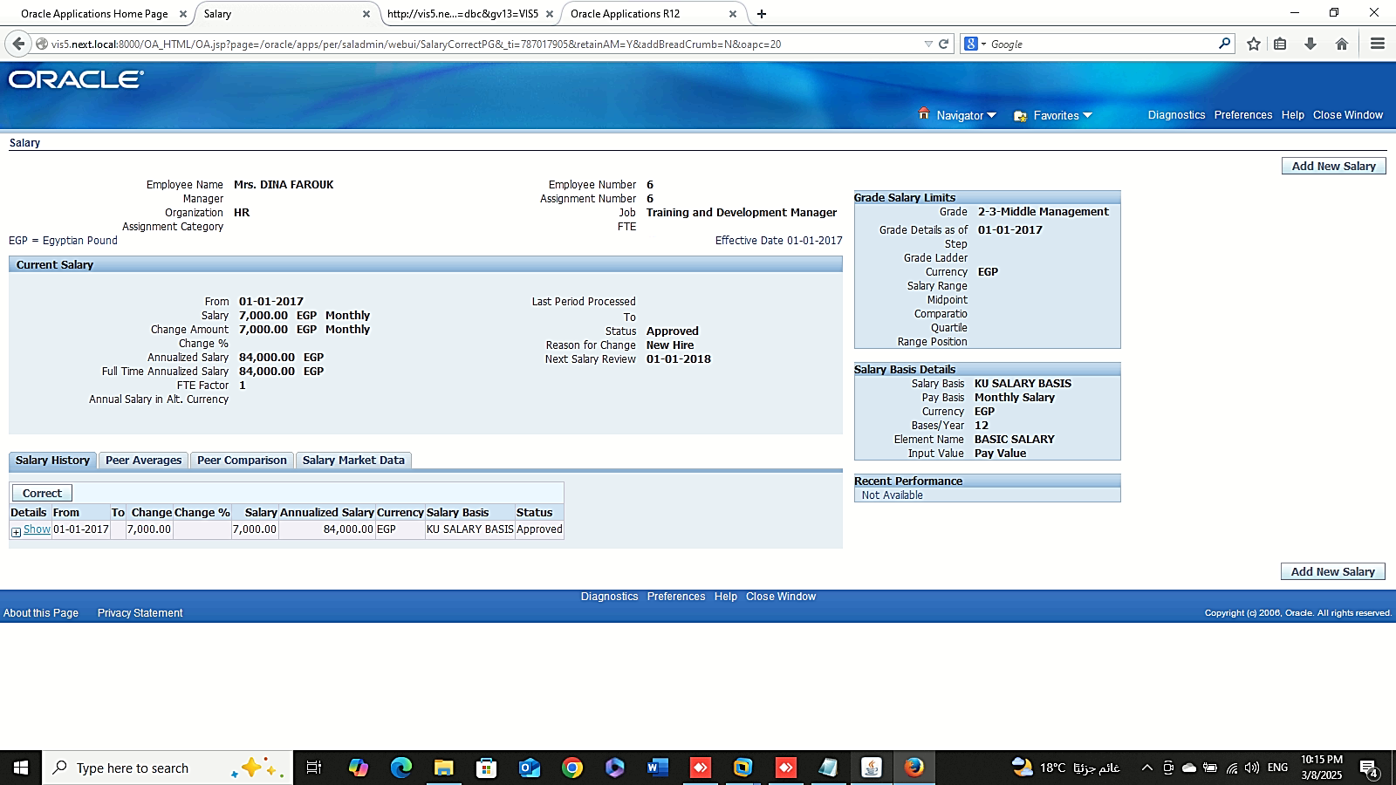
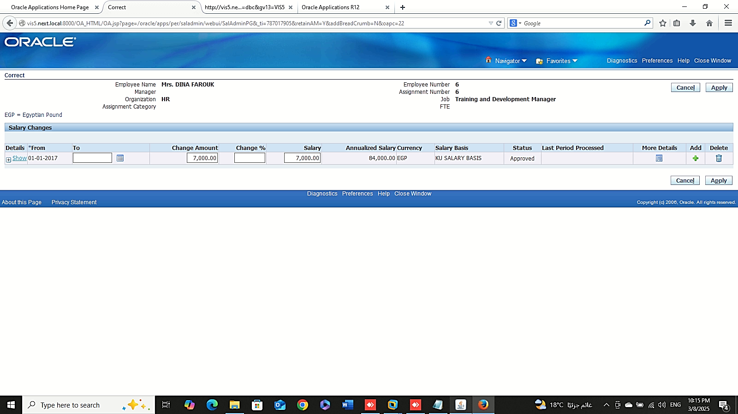
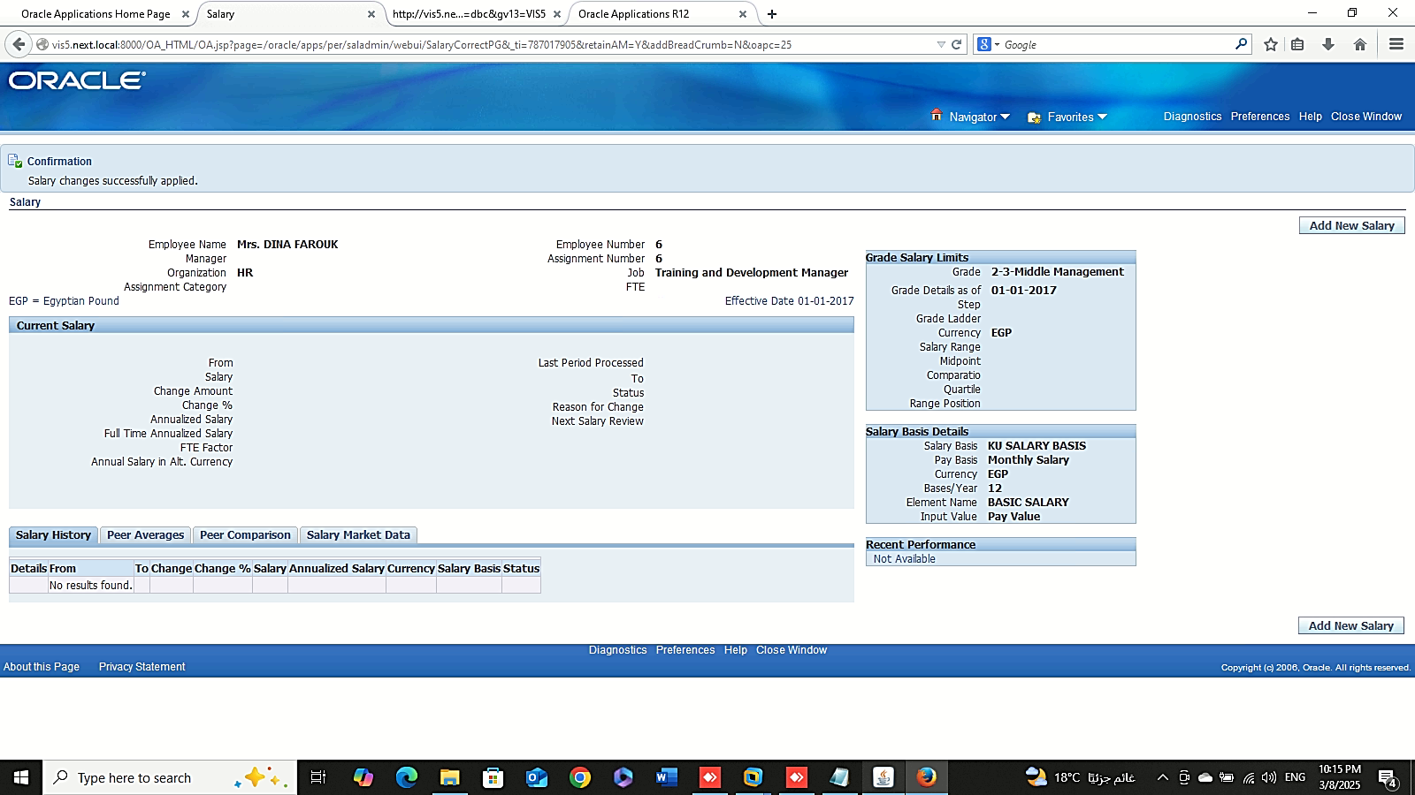
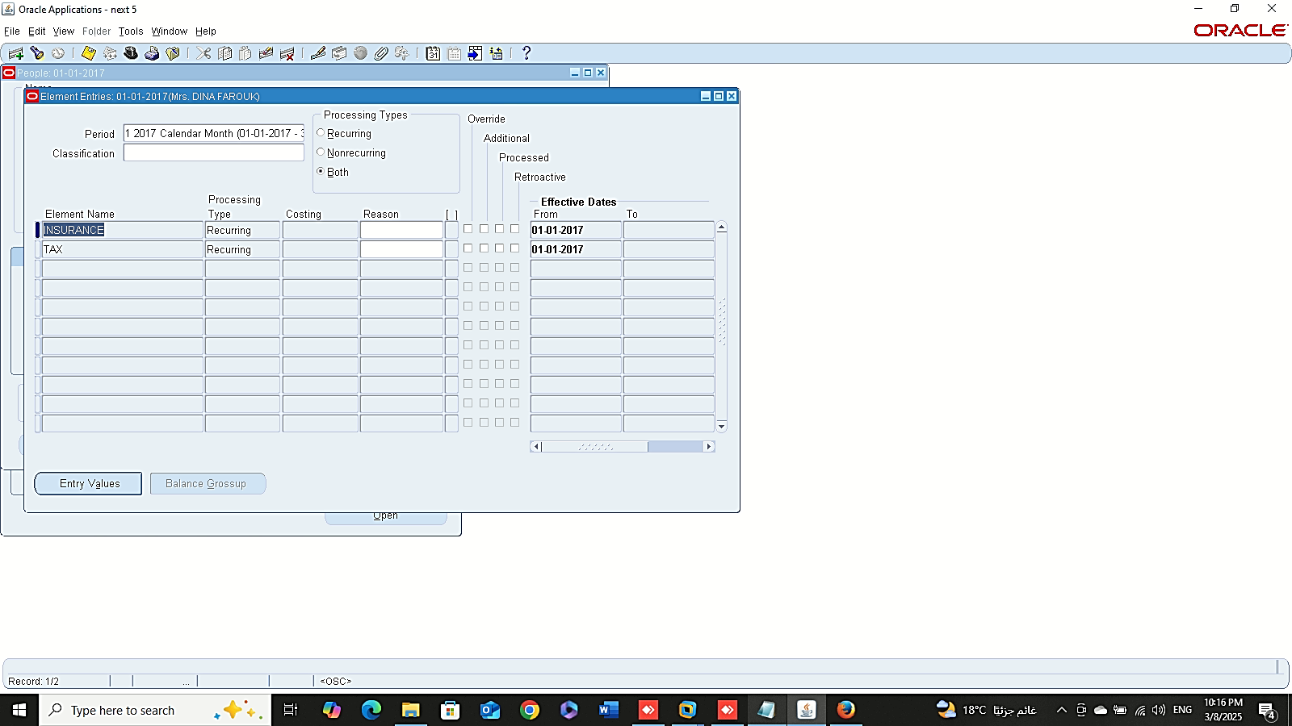
Finance Management (Payroll)
Delete Salary Basis

Slide 6
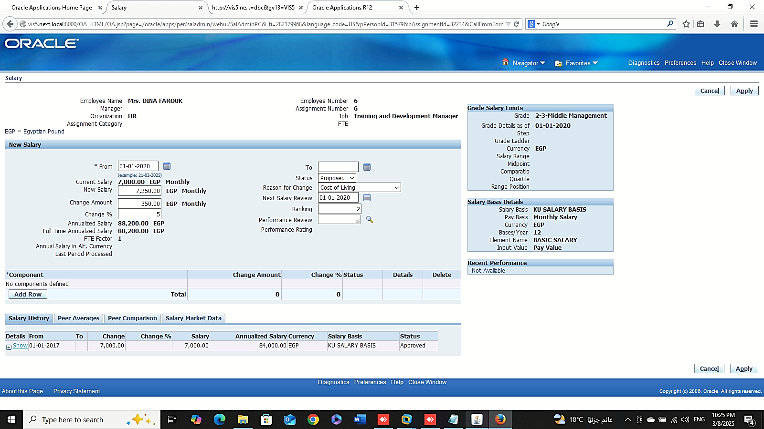

Add New Salary
Finance Management (Payroll)
New Salary
1- Add New Salary:
GLOBAL HRMS MANAGER > PEOPLE > ENTER AND MAINTAIN > FIND > ASSIGNEMENT > SALARY

Slide 7
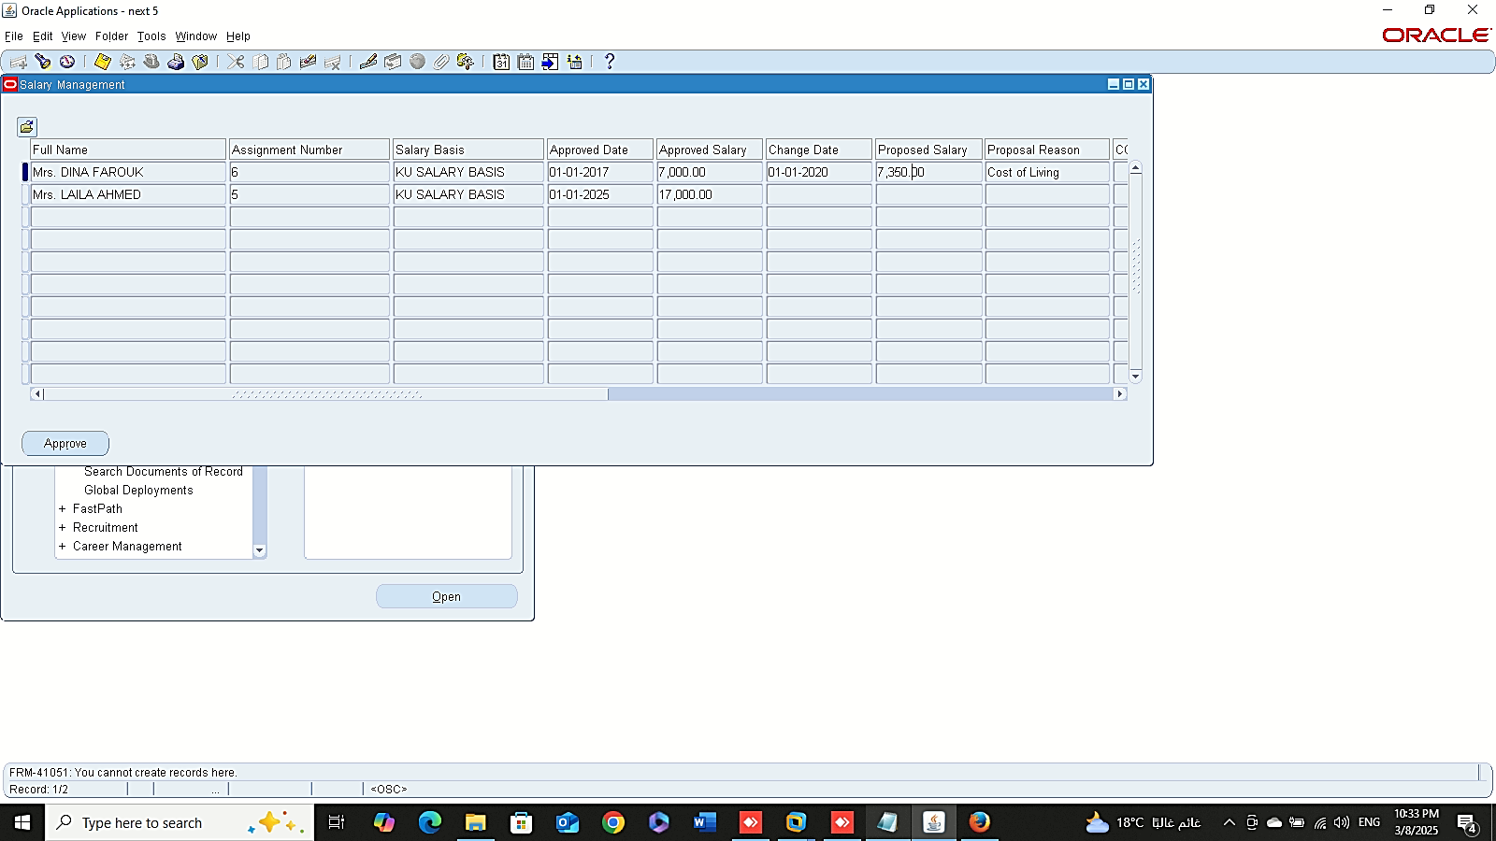
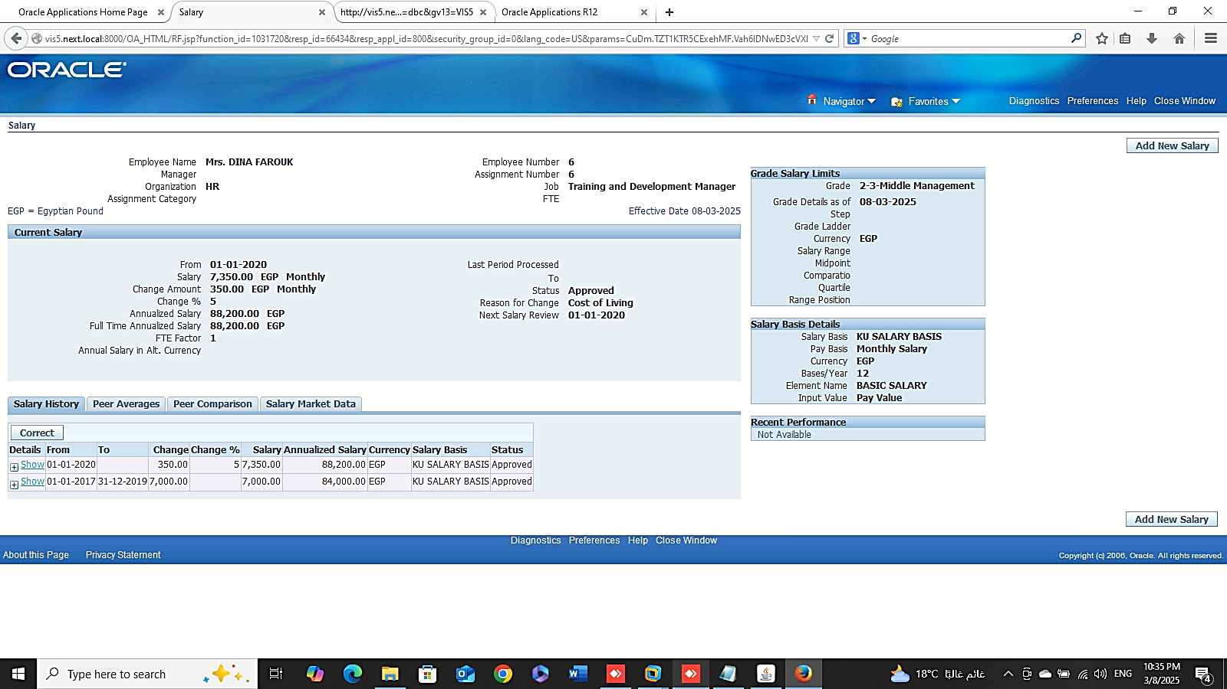
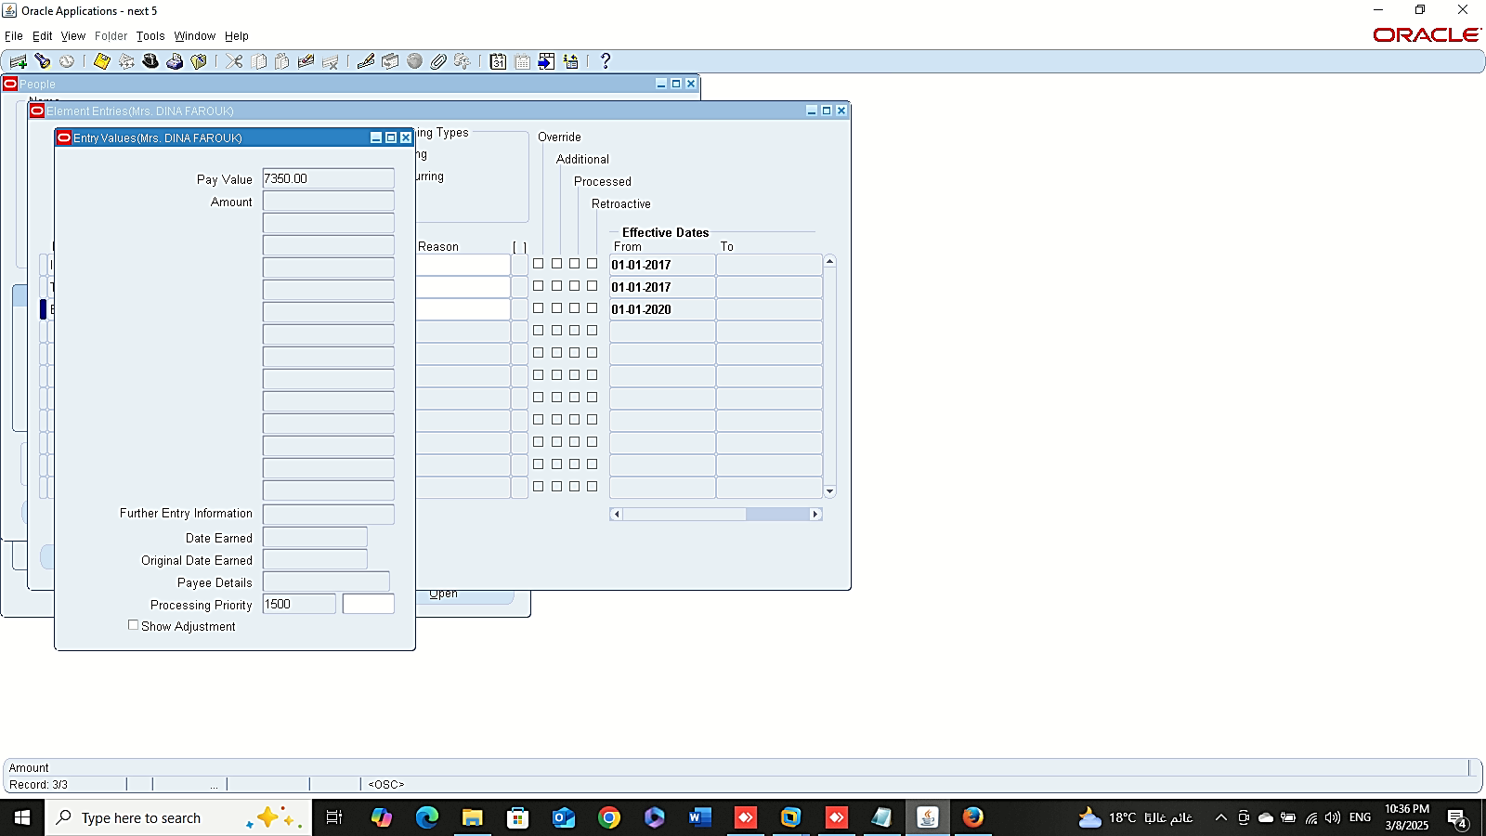
Finance Management (Payroll)
New Salary
2- Salary Management :
GLOBAL HRMS MANAGER > PEOPLE > SALARY MANAGEMENT

Slide 8
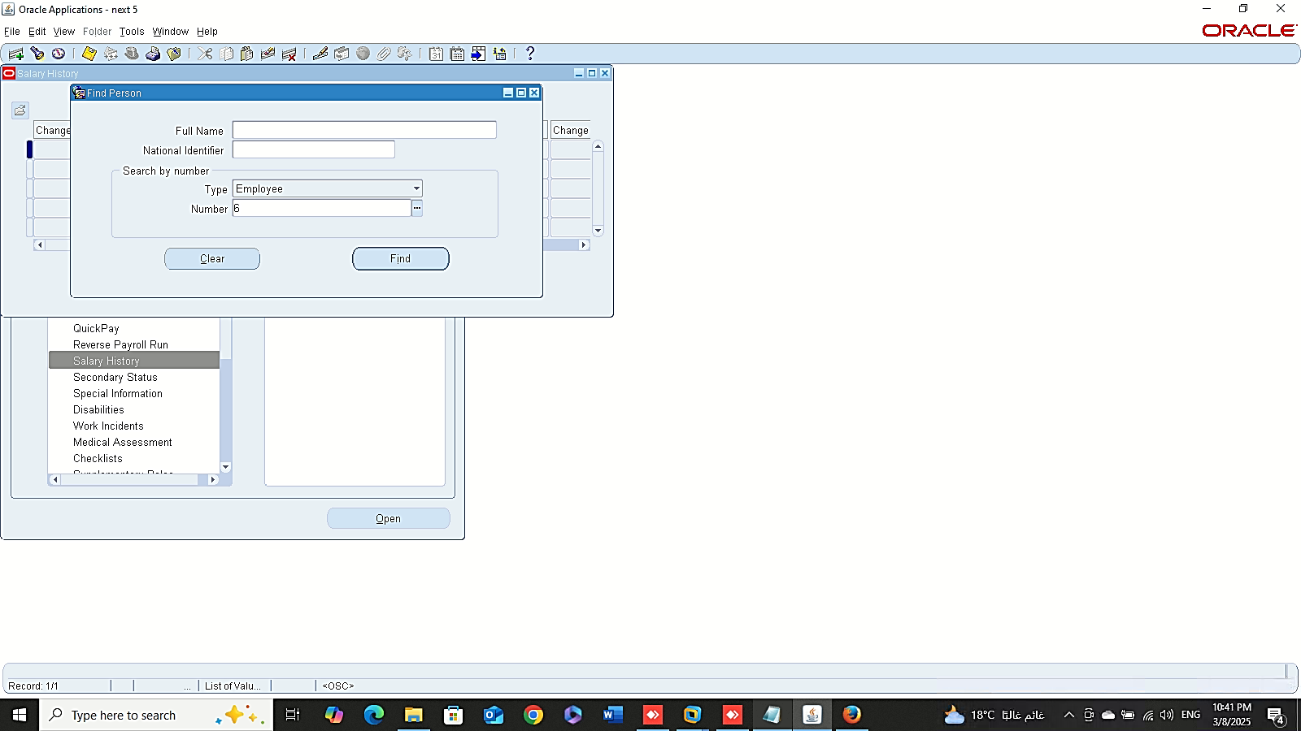
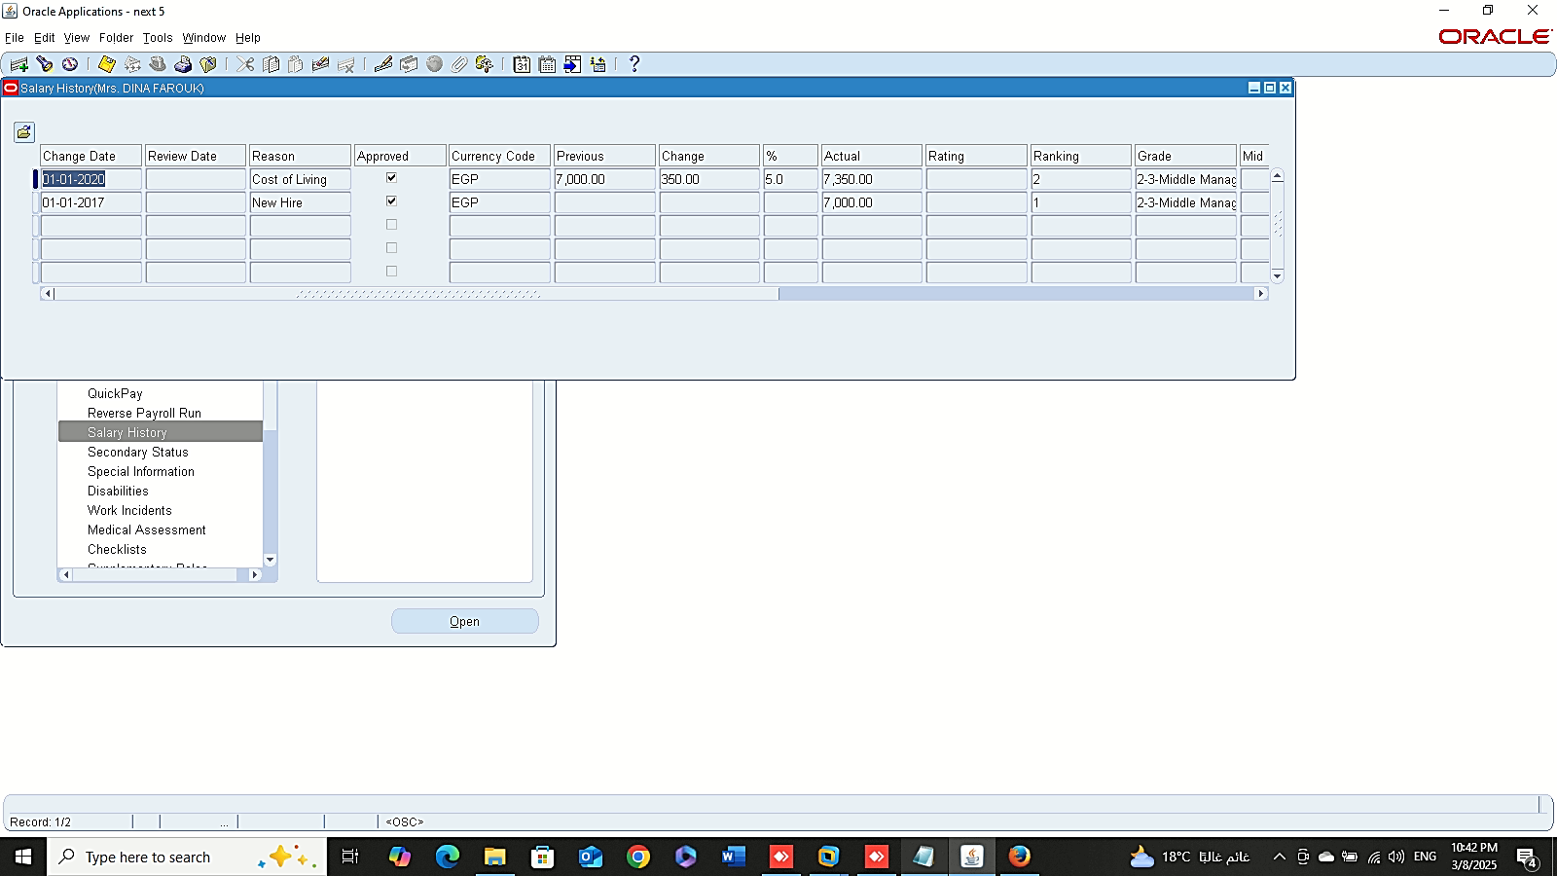
Finance Management (Payroll)
Salary History
Global HRMS MANAGER > FAST PATH > SALARY HISTORY

Slide 9
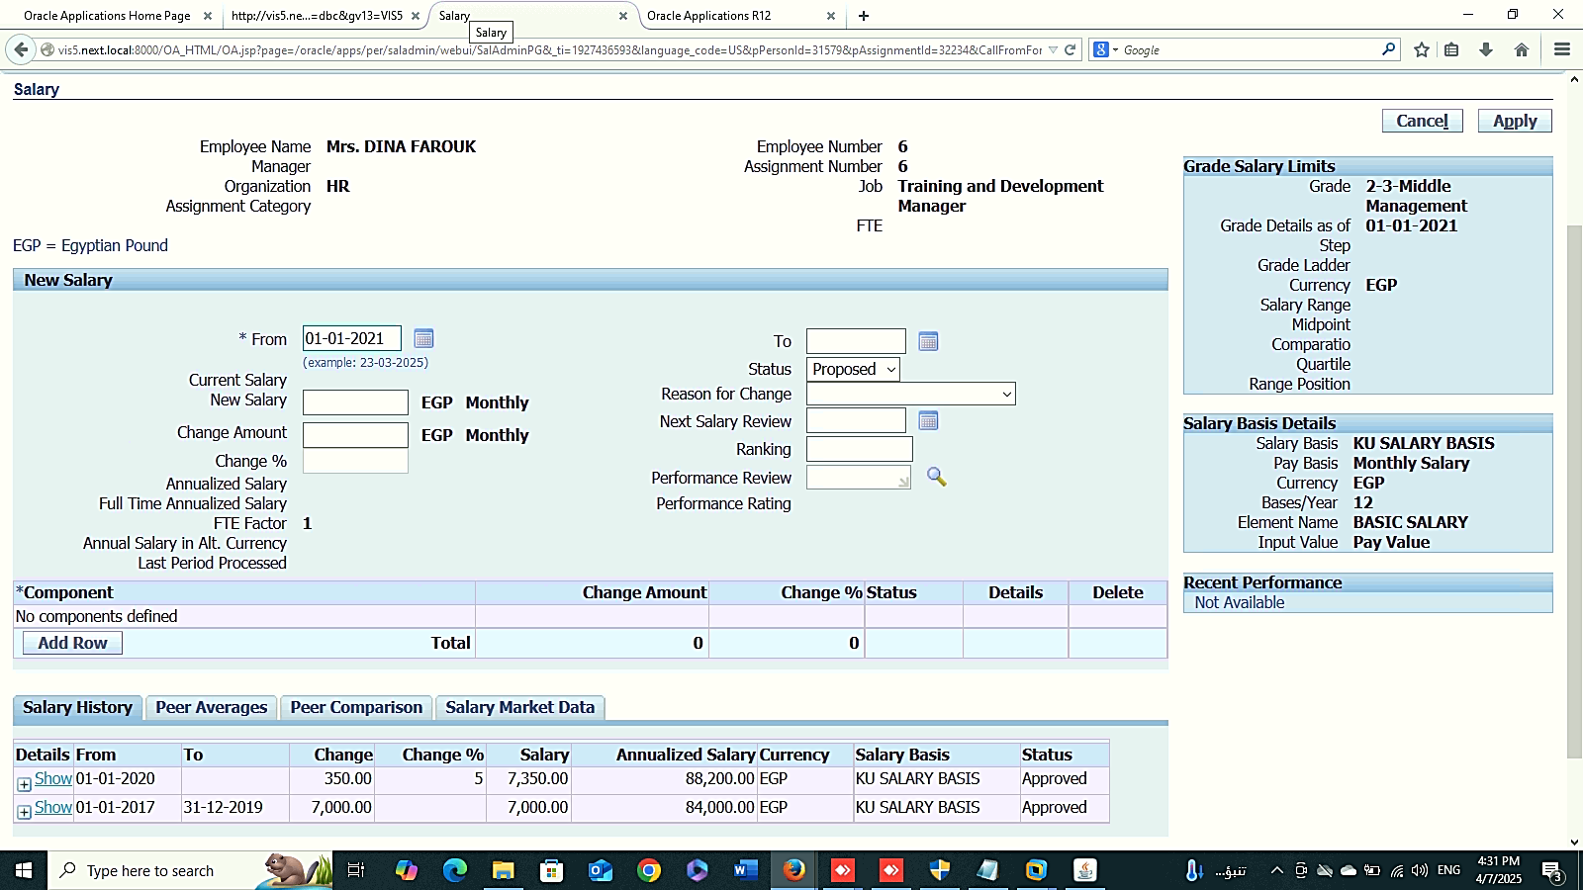
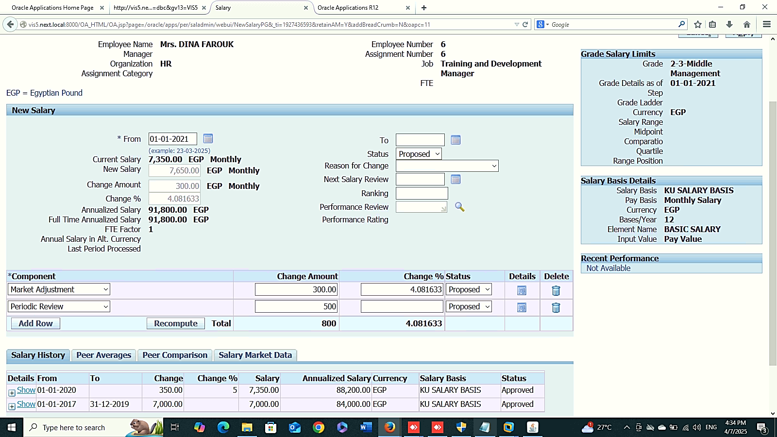
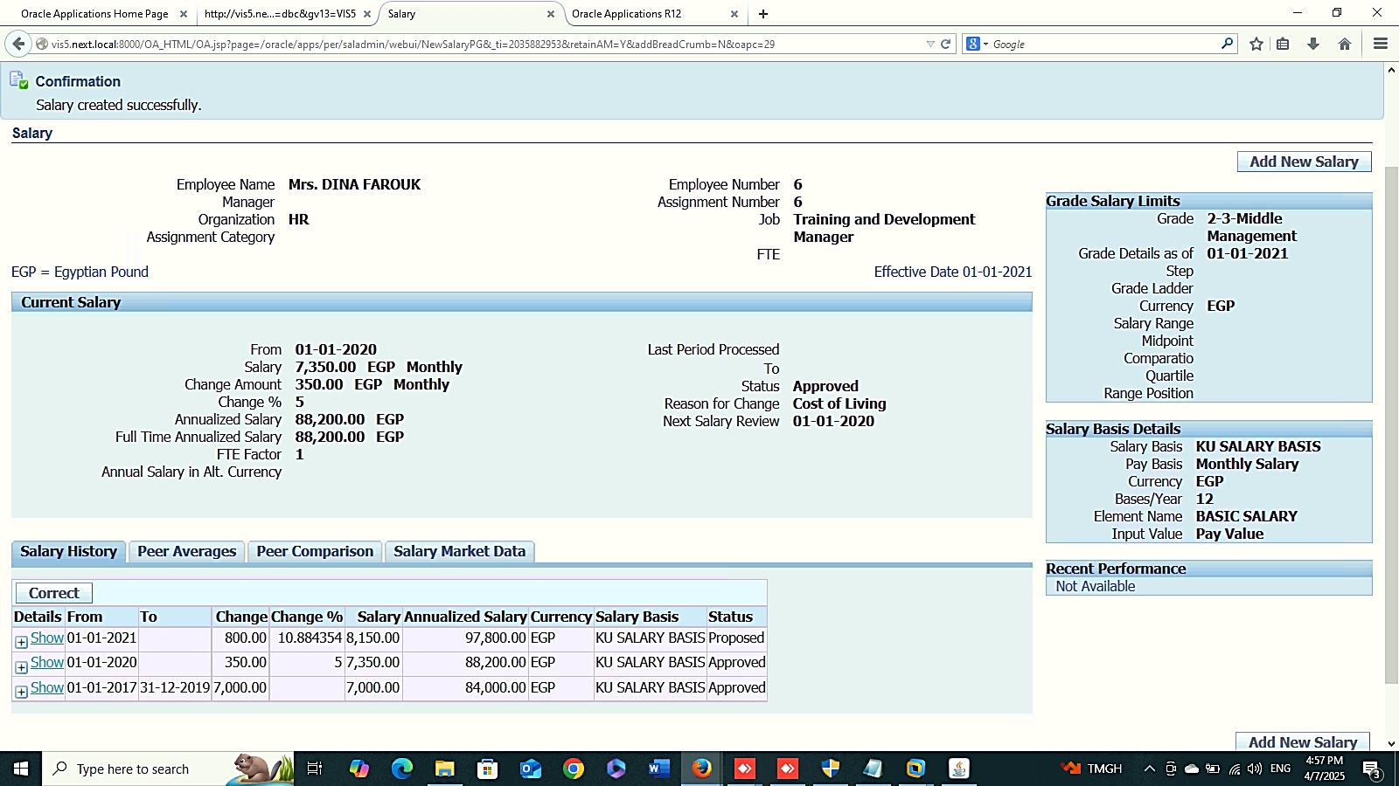
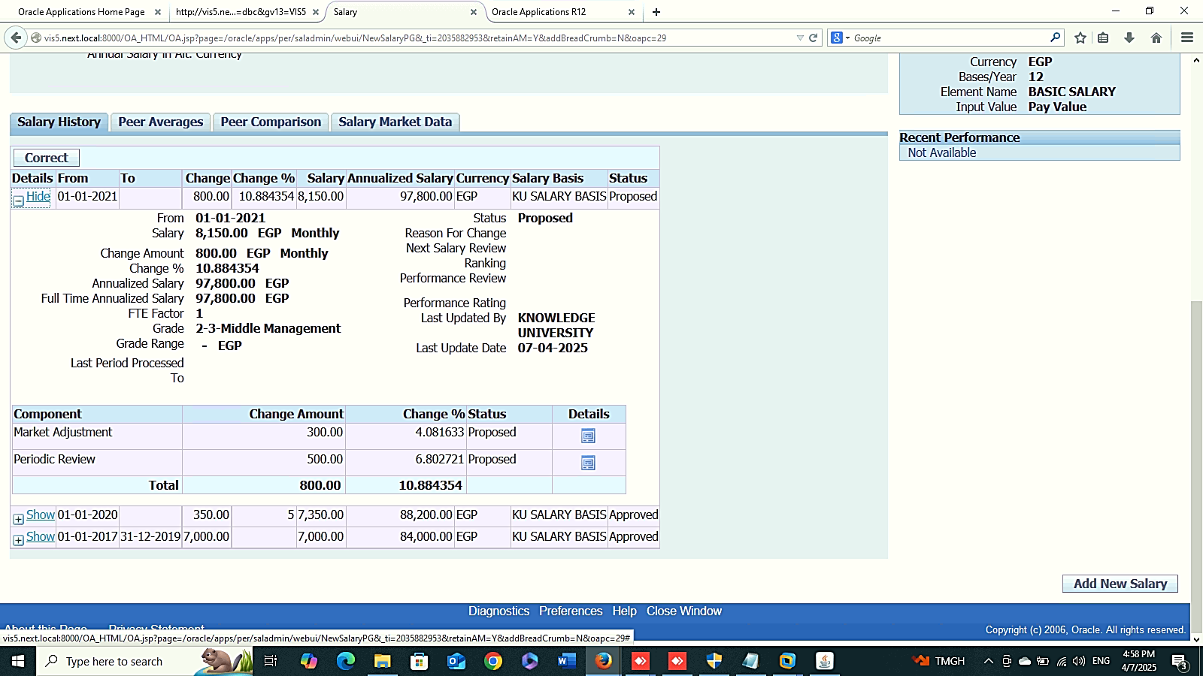
Finance Management (Payroll)
Salary Component
Global HRMS MANAGER > PEOPLE > ENTER AND MAINTAIN > FIND > ASSIGNMENT

Slide 10
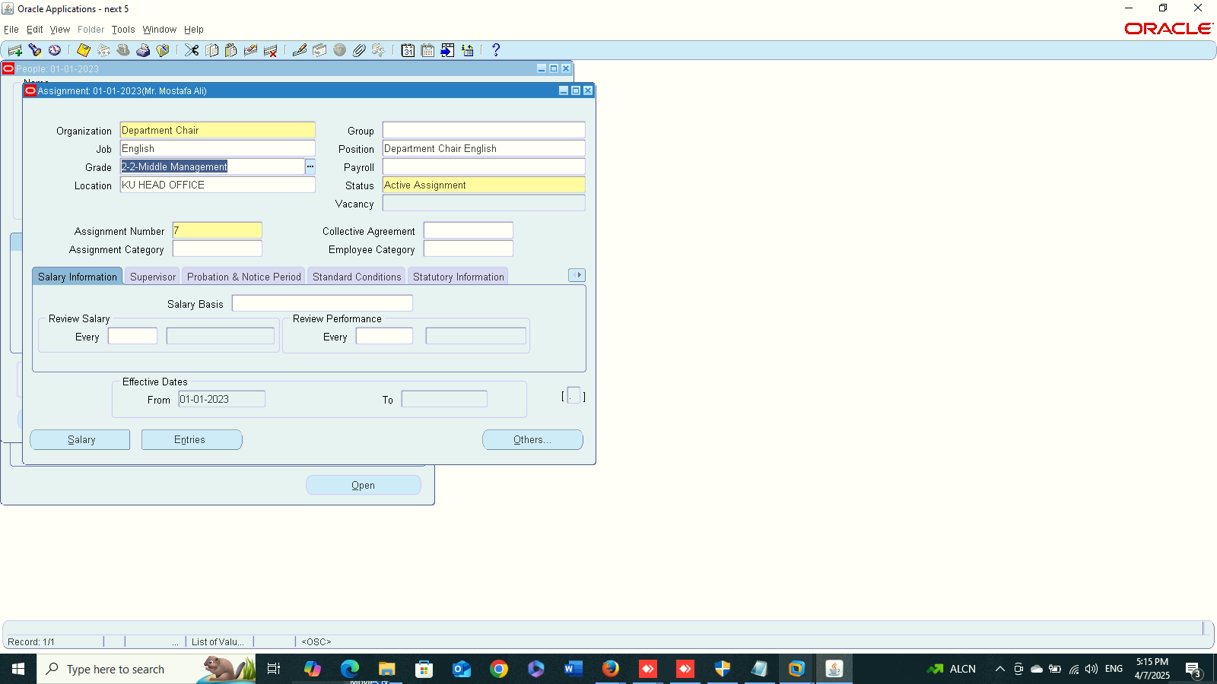
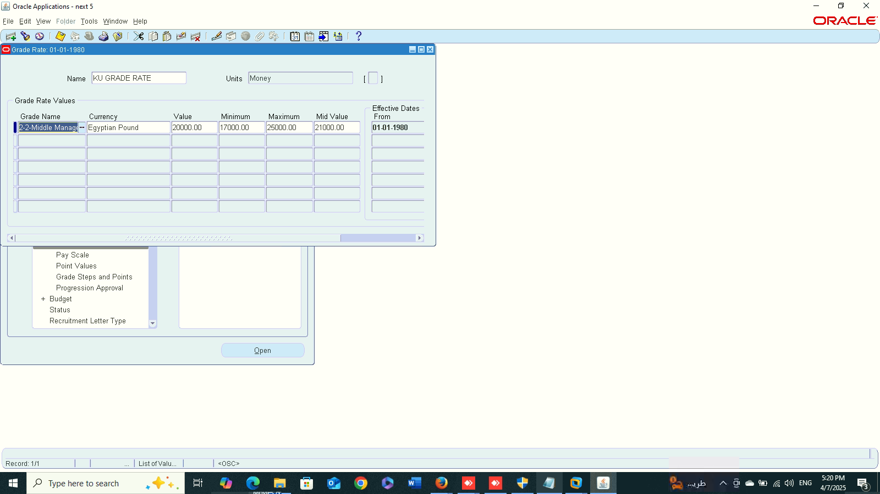
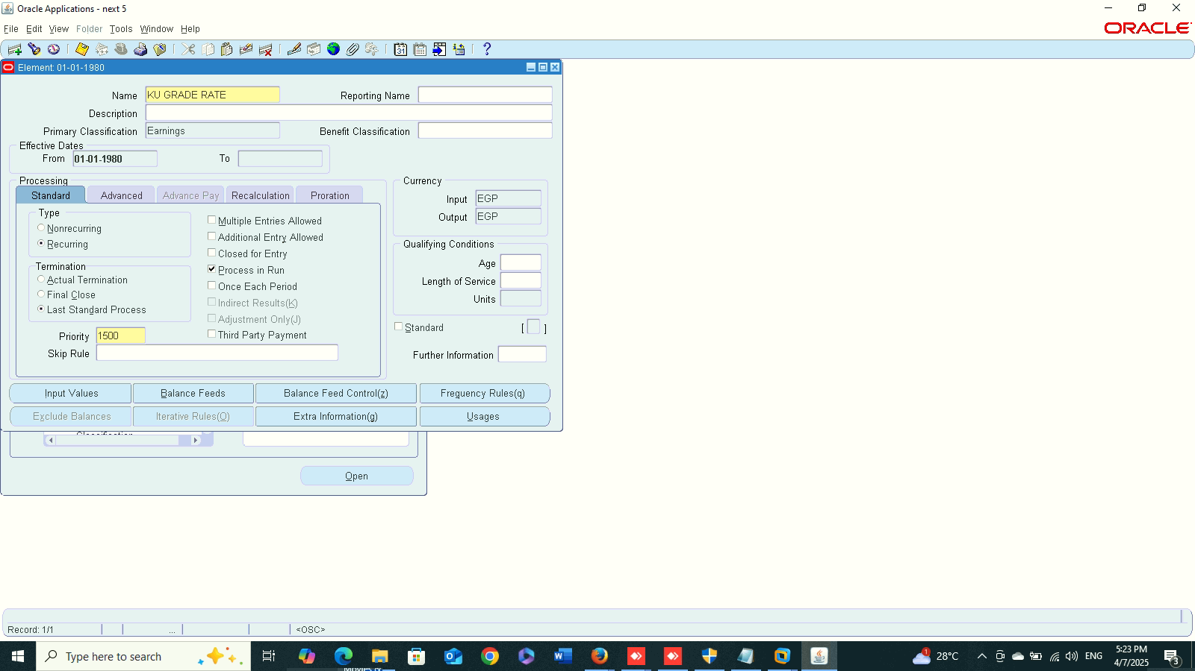
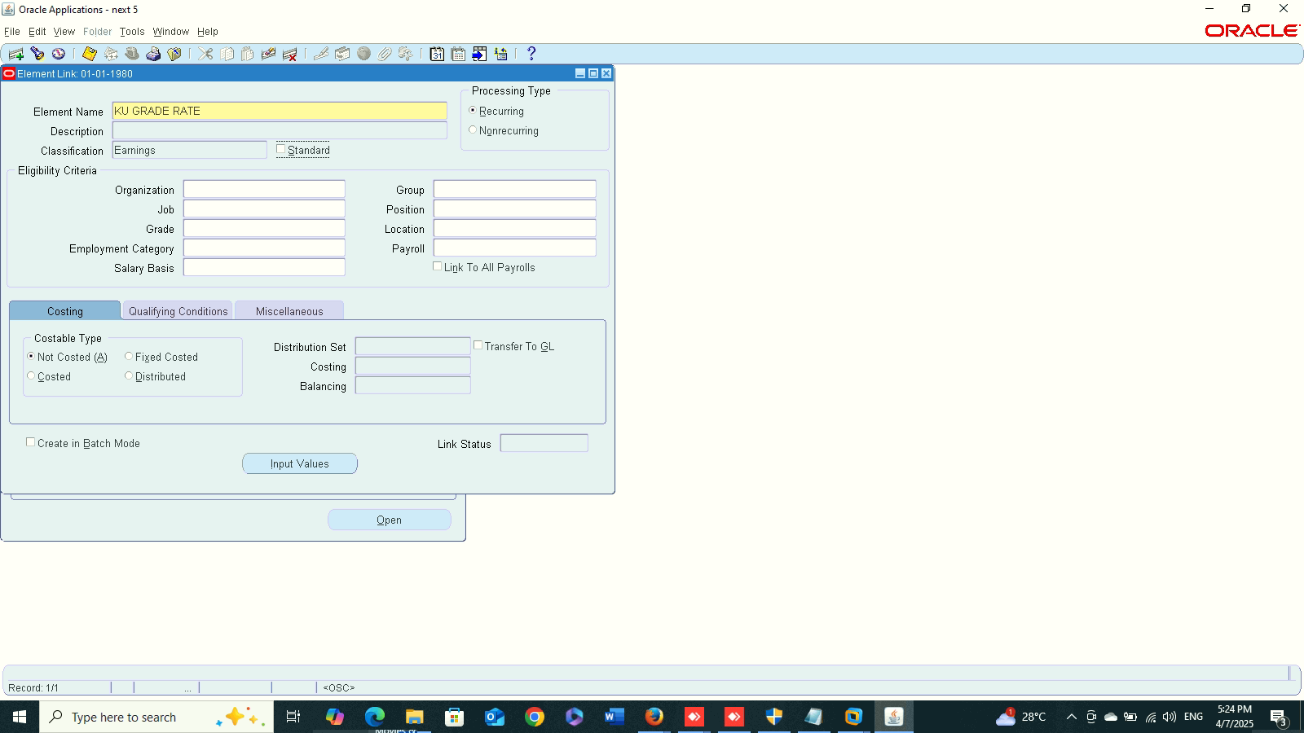
Create Grade Rate
Finance Management (Payroll)
Grade Rate:
1- Create Grade Rate :
Global HRMS MANAGER > WORK STRUCTURE > GRADE > GRADE RATE
2- Create a new element:
GLOBAL HRMS MANAGER > TOTAL COMPENSATION > BASIC > ELEMENT
3- Create a new link:
GLOBAL HRMS MANAGER > TOTAL COMPENSATION > BASIC > LINK
New Element
New Link

Slide 11
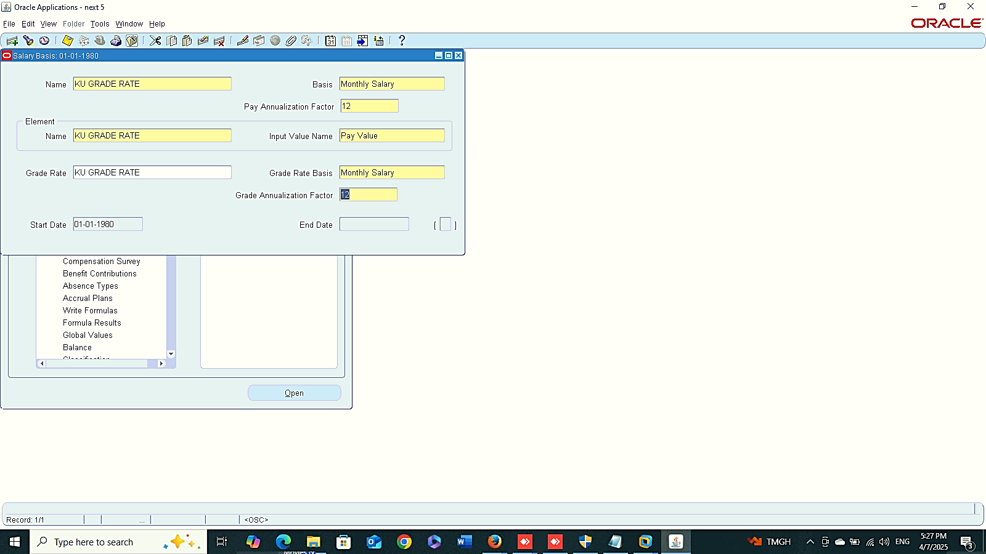
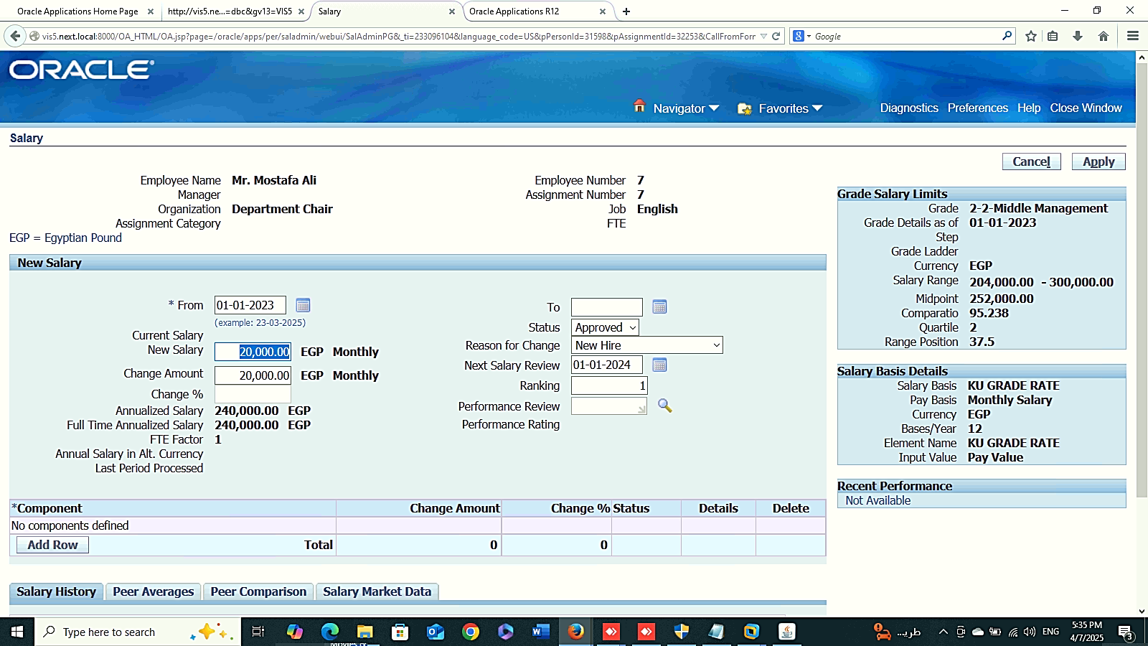
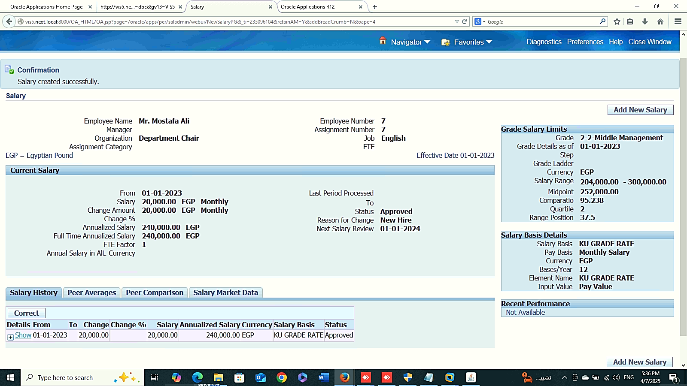
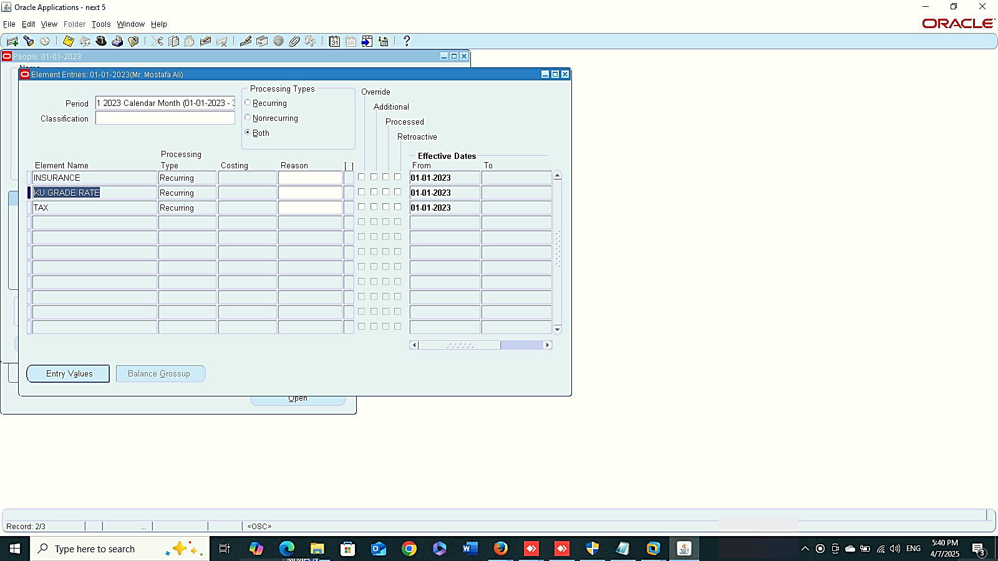
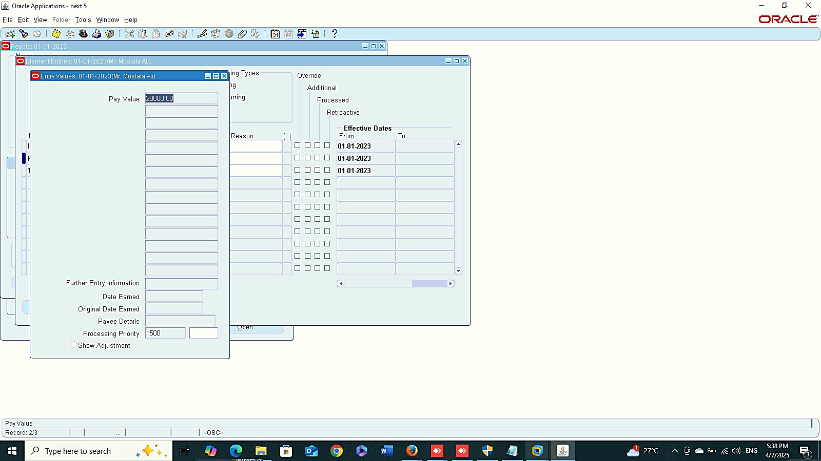
New Salary Basis
Add New Salary
1
Finance Management (Payroll)
Grade Rate:
4- Create New Salary Basis :
Global HRMS MANAGER > TOTAL COMPENSATION> BASIC > SALARY BASIS
5- Add New Salary
GLOBAL HRMS MANAGER > PEOPLE > ENTER AND MAINTAIN > FIND > ASSIGNEMENT> SALARY
2
3
4
New Link

Slide 12
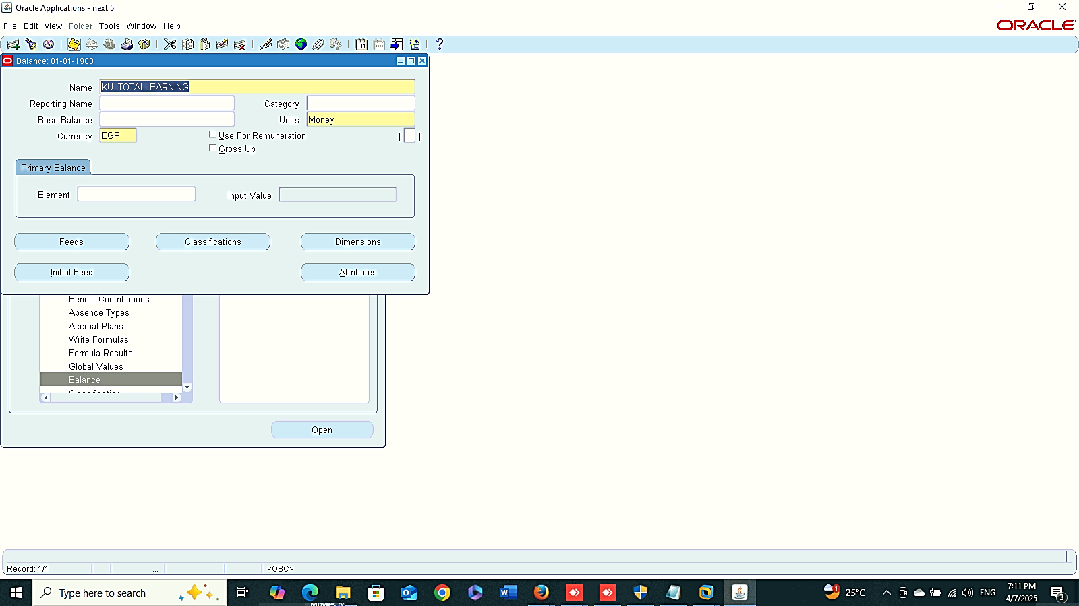
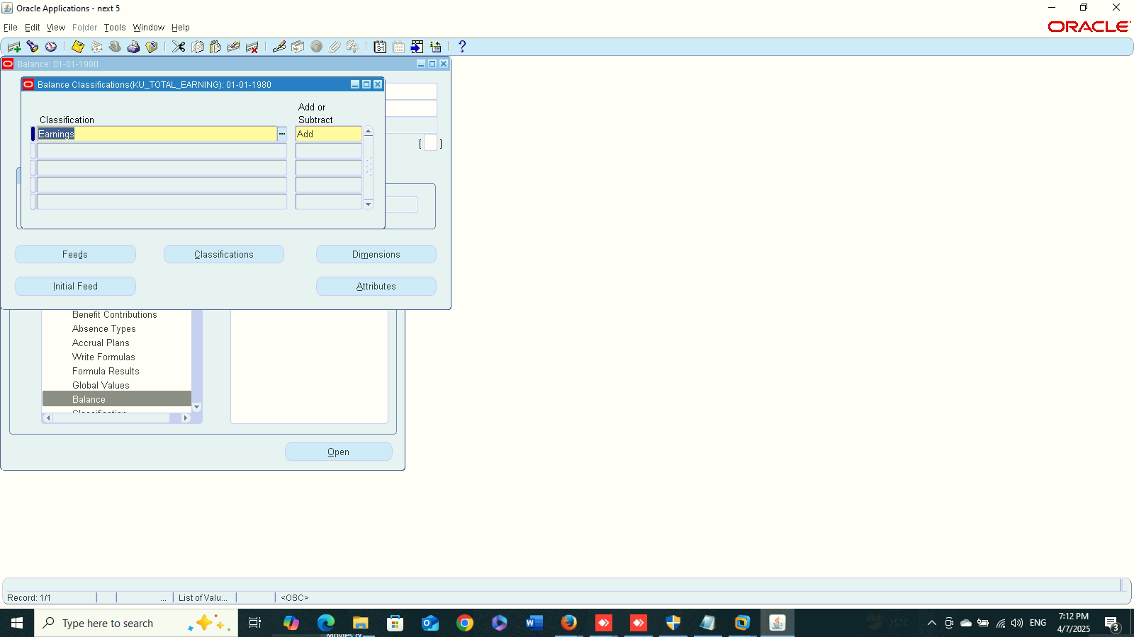
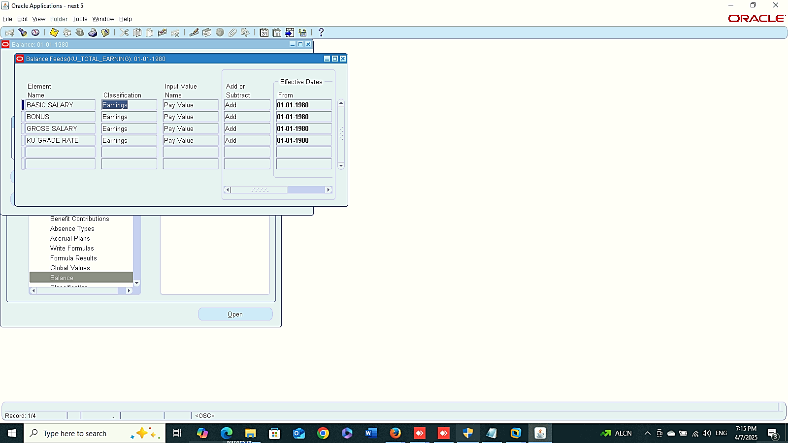
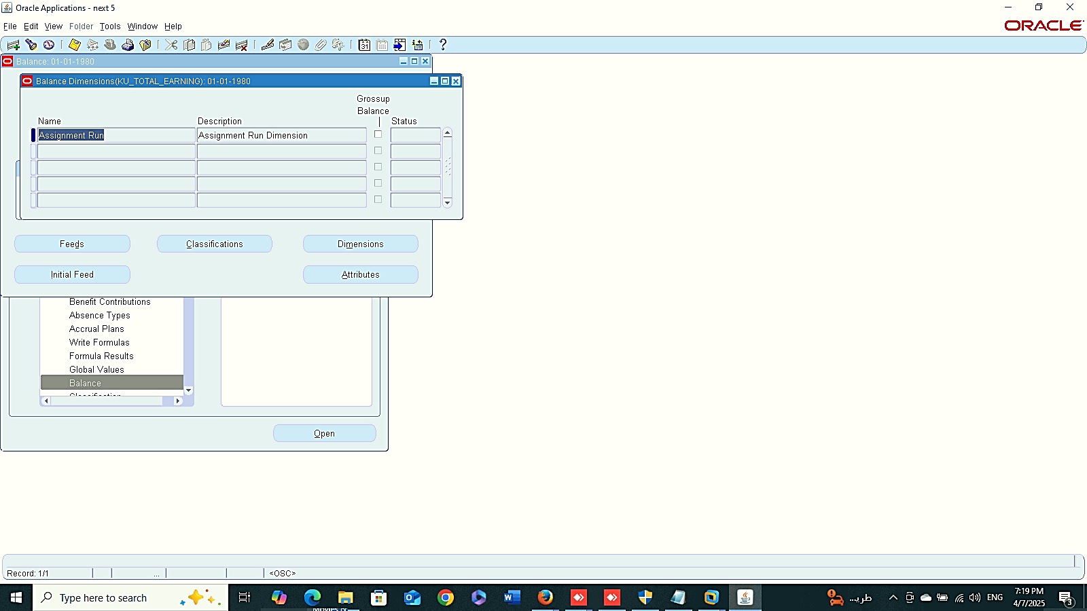
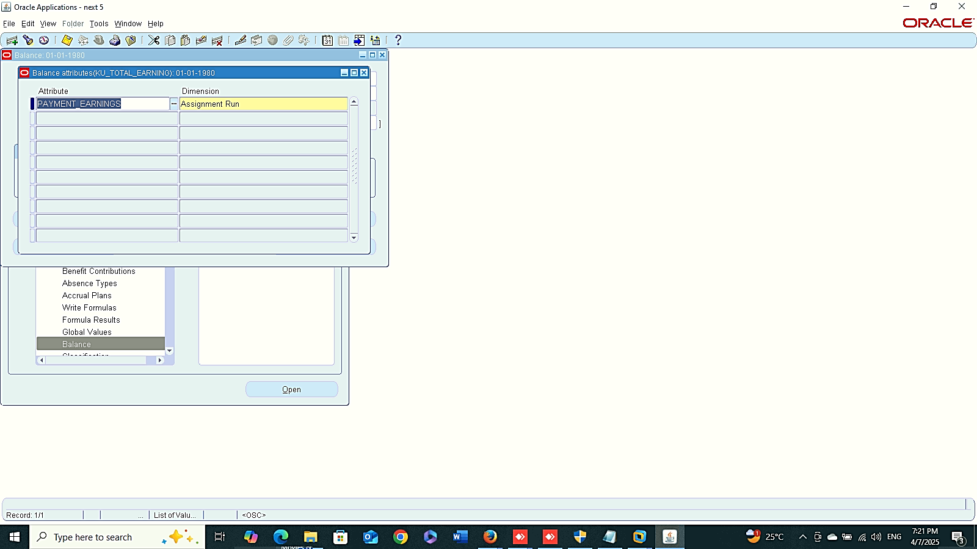
Earning
Classification
Finance Management (Payroll)
Balance:
Global HRMS MANAGER > TOTAL COMPENSATION> BASIC > Balance
1- Earning
Classification
Feeds
Dimension
Attributes
Feeds
Dimension
Attributes
2
3
4

Slide 13

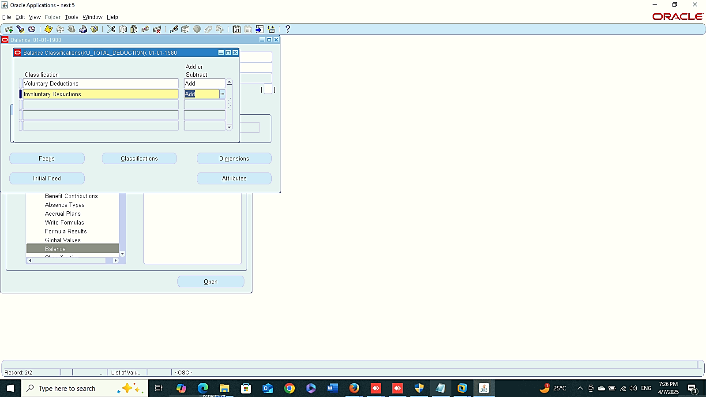
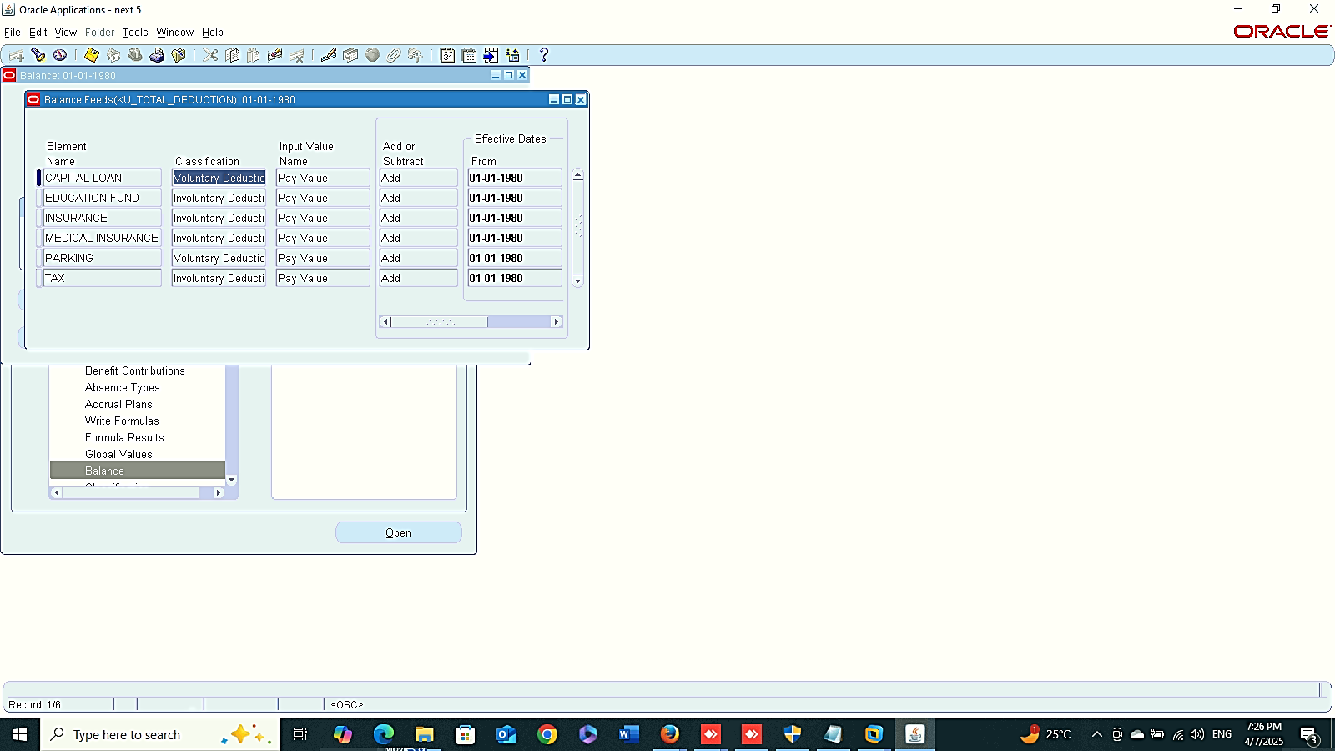

Deduction
Classification
Finance Management (Payroll)
Balance:
Global HRMS MANAGER > TOTAL COMPENSATION> BASIC > Balance
2- Deduction
Classification
Feeds
Dimension
Feeds
Dimension

Slide 14
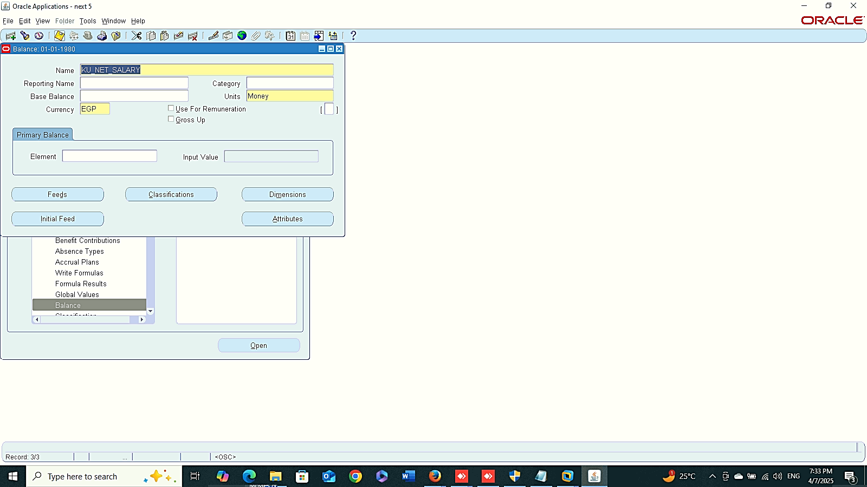
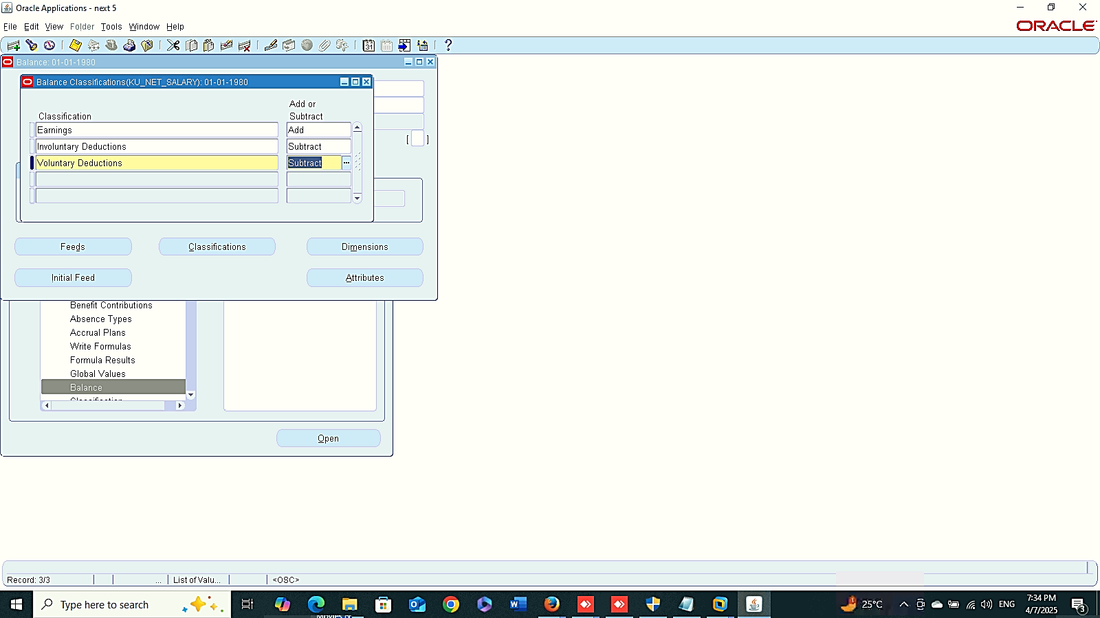
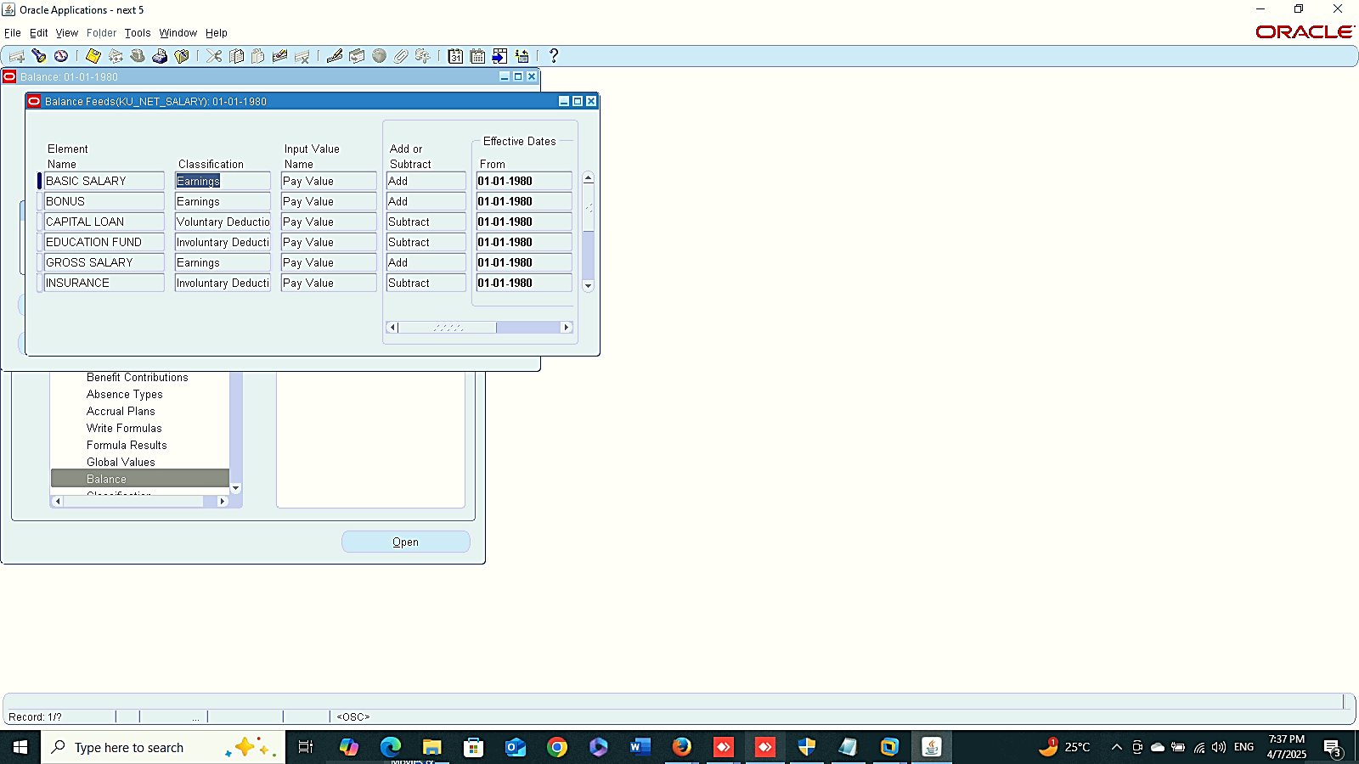

Net Salary
Classification
Finance Management (Payroll)
Balance:
Global HRMS MANAGER > TOTAL COMPENSATION> BASIC > Balance
3- Net Salary
Classification
Feeds
Dimension
Feeds
Dimension

Slide 15
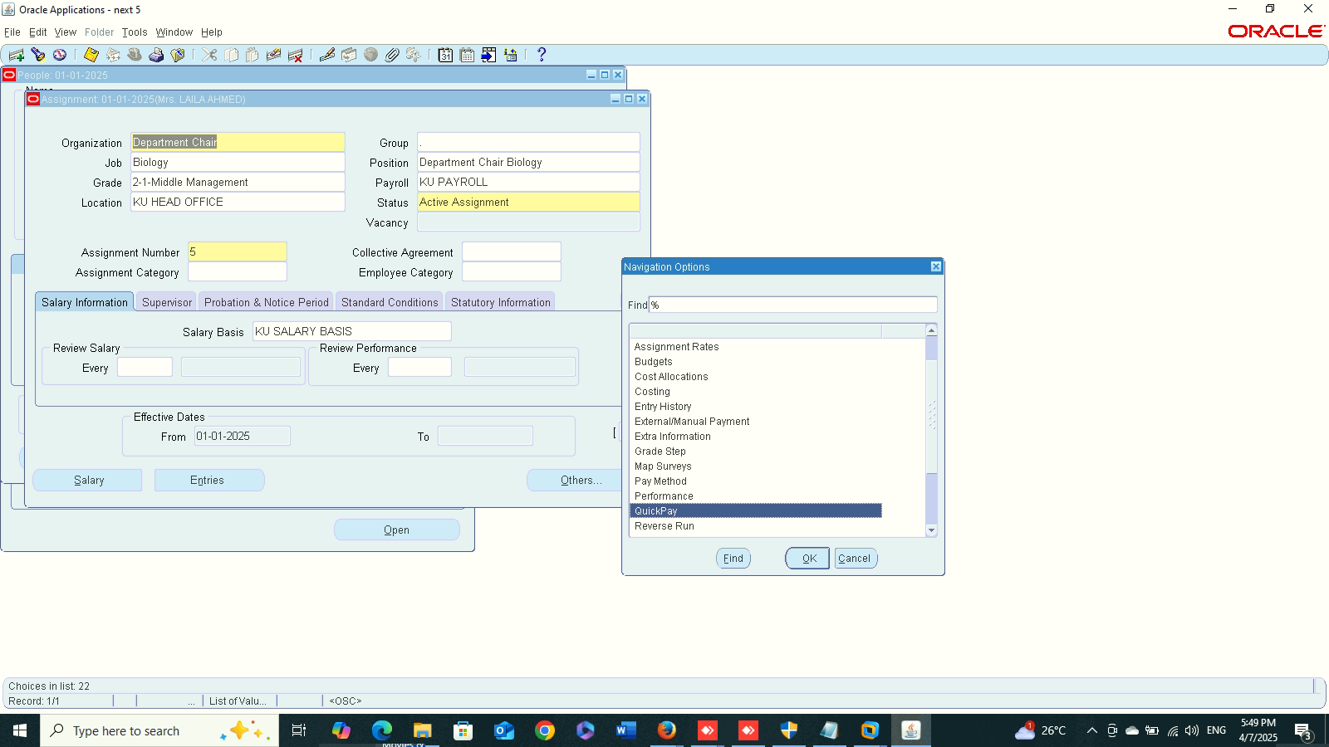
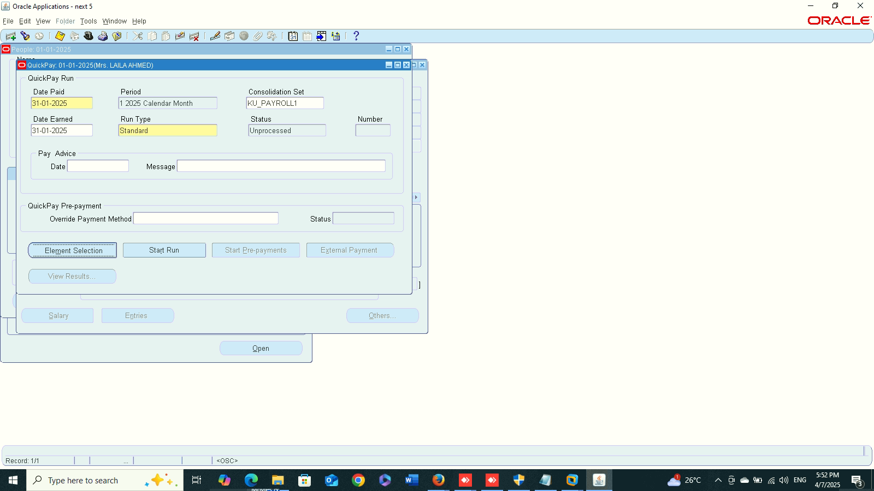
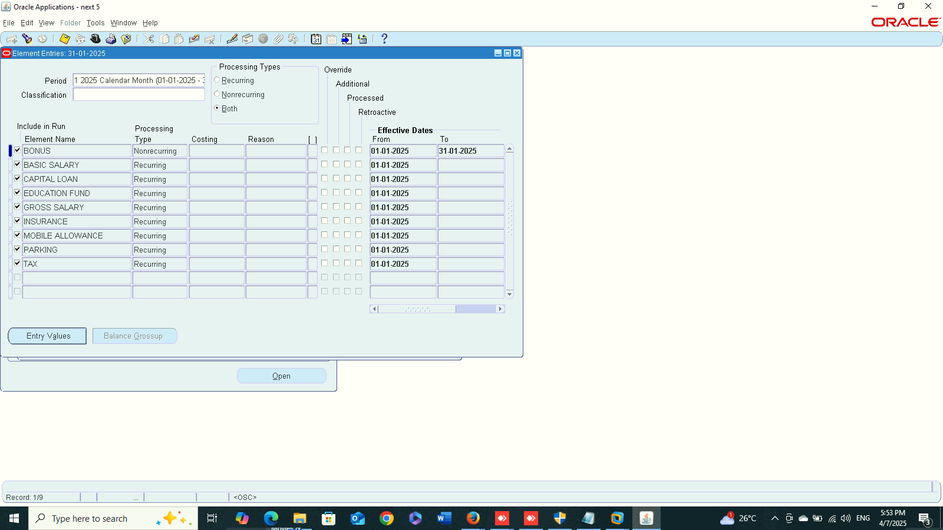
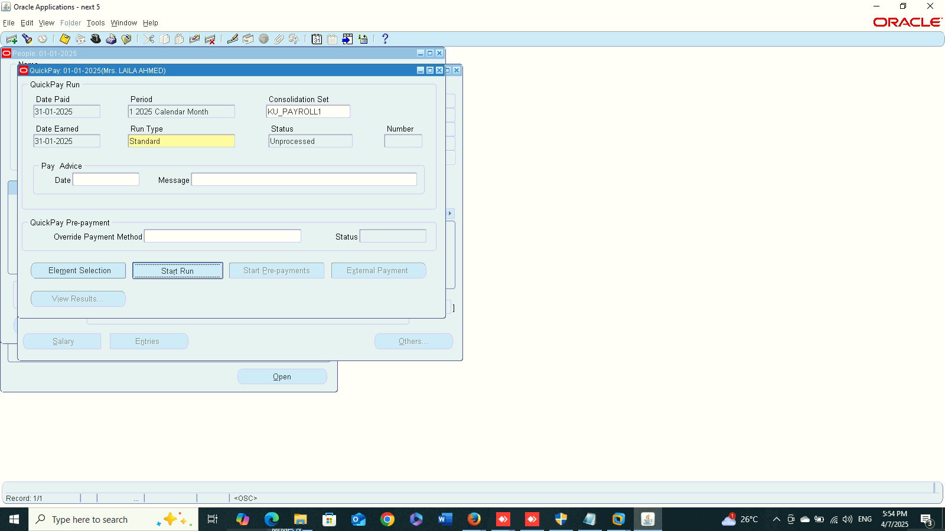
1
2
Finance Management (Payroll)
Quick Pay:
Global HRMS MANAGER > PEOPLE > ENTER AND MAINTAIN > FIND > ASSIGNMENT > OTHER
3
4

Slide 16

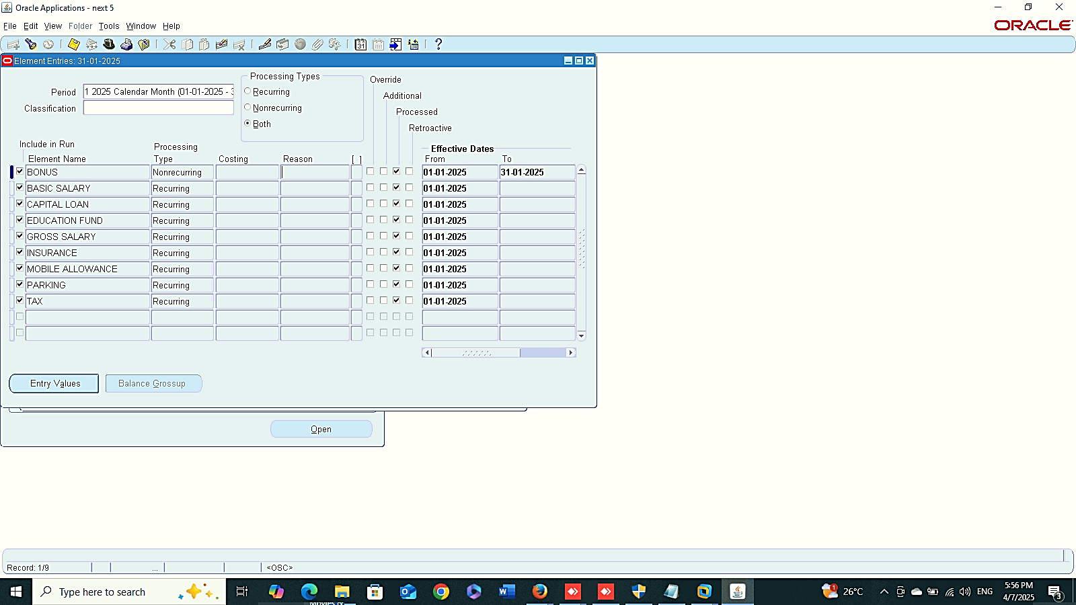




5
6
7
Finance Management (Payroll)
Quick Pay:
Global HRMS MANAGER > PEOPLE > ENTER AND MAINTAIN > FIND > ASSIGNMENT > OTHER
8
9
10

Slide 17





Net Salary
Deduction
Finance Management (Payroll)
Net Salary
Total Deduction
Total Earning
Delete Quick Pay:
Global HRMS MANAGER > PEOPLE > ENTER AND MAINTAIN > FIND > ASSIGNMENT > OTHER > QUICK PAY > DELETE
Earning
Delete Quick Pay
1
2

